Slide 1
¡Bienvendios a la clase de 3H!
F.L.A.C.S- Foreign Language Association
of Chairpersons and Supervisors
NY State Regents Exams were discontinued in the area of World Languages.
Fortunately former CSH chairperson, Carmen Campos and her colleagues from
other Long Island school districts, united to create a comparable exam to
replace the 8th grade as well as the 10th grade language exams.
These will count in your child’s pursuit of an Advanced Regent’s Diploma.
*Test is during Regent’s
week in June 20
Please don’t make plans
for camp or vacation
NO MAKE-UPS SAME YEAR

Slide 2
Last year I implemented Twitter into my routine. The students would come into class and
respond to a post in Spanish while I am checking the homework.
They really enjoy being creative in their responses as well as reading their classmates posts.
We discuss some grammatical points and useful vocabulary for each task. In the past
students would write their responses in their notebooks and then read them aloud,
now they read each response on the SmartBoard, a more interactive activity. They pay
attention to the activity more than ever.
Students love technology!

Slide 3
Curriculum
Themes/Big Ideas for LOTE/World Languages
Personal ID/Social Relationships
Biographical Data/Personal Description
Family Life
Celebrations
Social Events
Meal Taking
Educational Systems
House and Home
Leisure
Social Customs
Volunteerism
Social Media
Global Awareness
Health & Welfare
Environmental issues
Food
Current Events
Language & National Identities
Government, Politics & Geography
Historical Events & Figures
Global Challenges & Economic Issues
Communication/Science Technology
Physical Environment
Climate/Weather
Food
Technology
Media
Internet & Communication
The Arts
Current Events
Fashion & Design
Architecture
Literature
Visual & Performing Arts
Music
Pop Culture
Contemporary Life
Educational/Careers
Travel/Lodging
Transportation
Leisure
Community/neighborhood
Shopping
Food

Slide 4
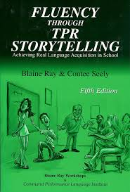
Learning and recognizing vocabulary
in context. Students acquire word
meanings with ease when it’s read
in a story versus being memorized
in list form. “Pop-up grammar” is
very short grammar explanations in
context, versus agonizing note-taking
and completing verb chart packets!

Slide 5
Quizlet
Students have access to Quizlet via my website. This site has all
of the vocabulary from the unit on electronic flashcards! They can also download
Quizlet to their phones in order to practice vocabulary in the car, bus etc!
username: monckrow

Slide 6
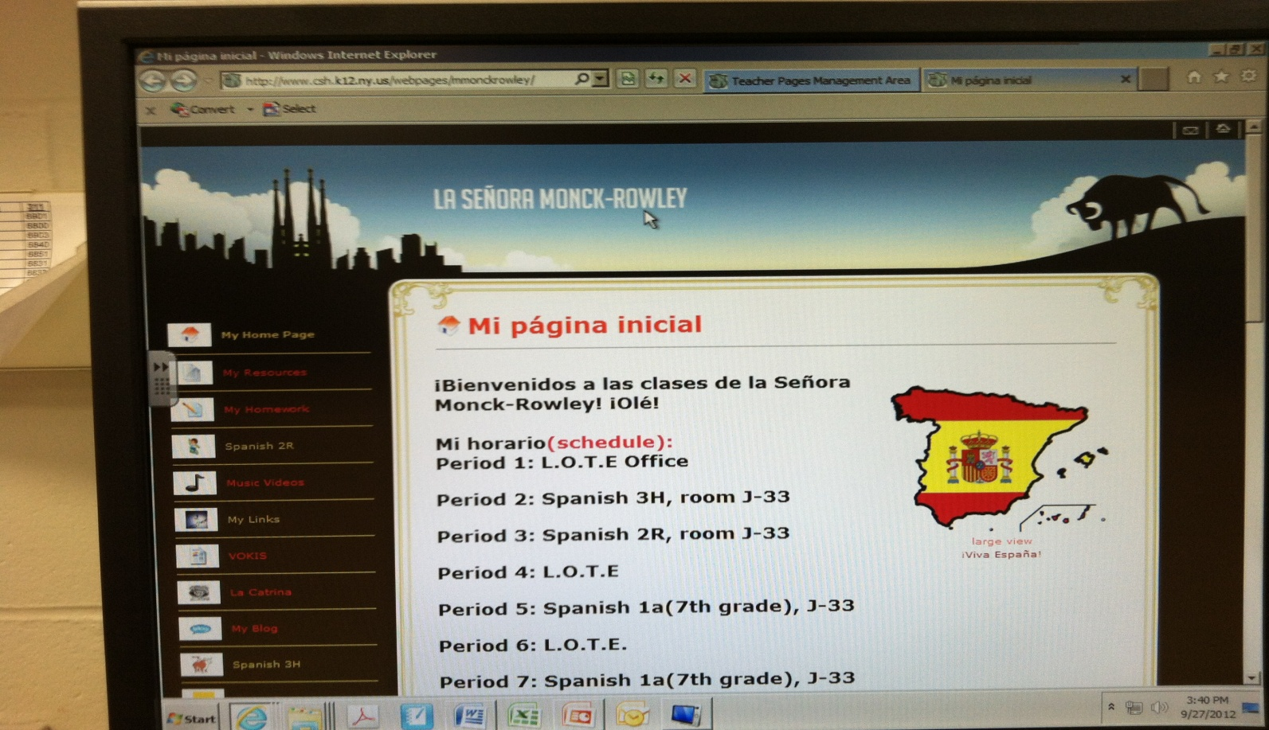
My website
Please visit my website and register for my emails. During the year I will
send home reminders for quiz dates, projects due dates, events etc.

Slide 7
La tarea
*Students are assigned hw during the week and sometimes on the
weekend!
* Missed assignments can be made up the next day for ½ credit!
If students are ill they can have an extra day to make up assignments
when they return to school
Please ask your child to email me for assignments when
they are absent mmonckrowley@csh.k12.ny.us

Slide 8
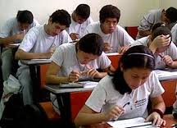
La prueba
Students will be quizzed weekly please check the parent portal up to a week later for the results
-Test days are Wednesday
-Tuesday is a free day
-I stick to my given day
-Students have 10 listening questions ahead of time
and I select five the day of the quiz

Slide 9
Speaking=25% of grade
This is not participation! Students will have to speak at the end of the year for
the FLACS Regional Exam for 25points. The LOTE department considers
speaking to be a huge component of the grade! It’s a language they should be able
to converse in a simple conversation by the end of the year.
Final Exam=FLACS
25 points is Speaking!

Slide 10
La ayuda extra
LOTE Office
I am in the LOTE office by 7:00-7:30 am EVERYDAY!
Students can make an appointment
to see me or they can stop in for help.
Great idea to review material
day before the quiz!

Slide 11
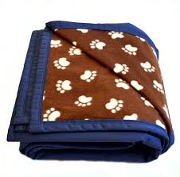
ARC= Animal Rescue Club
This year the ARC has been reinstated! Señorita Wilkens and I are
both co-advisors for this club and it is open to grades 7-12. The club we host fundraisers
as well as build cat houses and play ramps for the Huntington Little Shelter. Mr Healy
in woodworking will also be working with us on these projects.
-This winter we will collect blankets and towels for the shelter!
Plus many bake sales

Slide 12
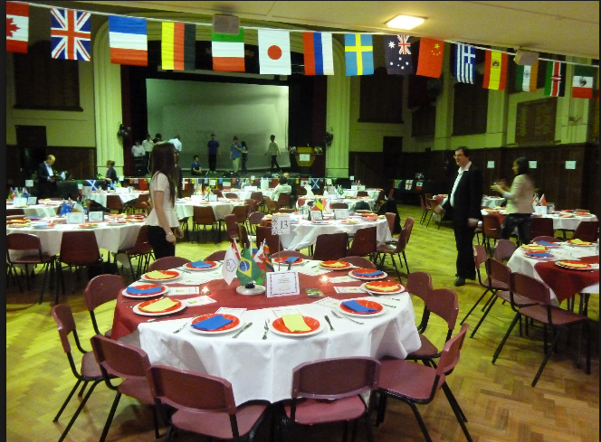
International Club!
Madame Koob and I are co-advisors for this club. This year we
plan to visit the United nations for a tour, celebrate the Chinese New Year in
Manhattan and travel to Ellis Island. An in house event will be our first
annual International Night where we hope students will set up booths and share
their heritage!
Plus many bake sales!

