Slide 1
Nature Walk
By: Christopher Caldas, Sabrina Odierno, and Charlotte Campbell

Slide 2
Producer And Herbivore
This an example of a producer/herbivore relationship. The honey bee eats the thistle’s pollen, and the thistle’s pollen is spread to wherever the bee goes.

Slide 3
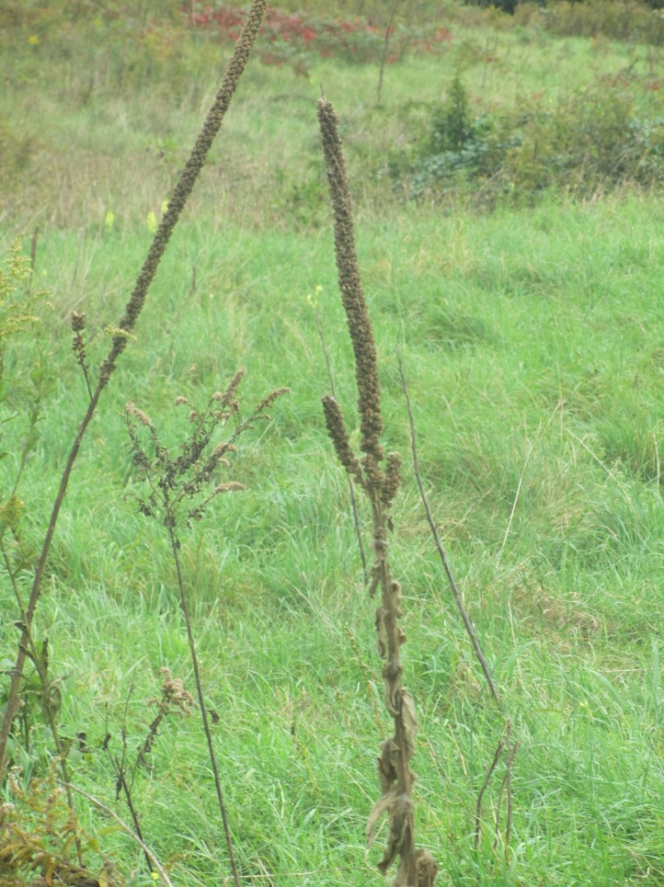
Decomposition
These are pictures of Decomposition. The picture of the rotting log (right) is slowly being broken down. The plants on the left are dead and will soon be recycled.

Slide 4
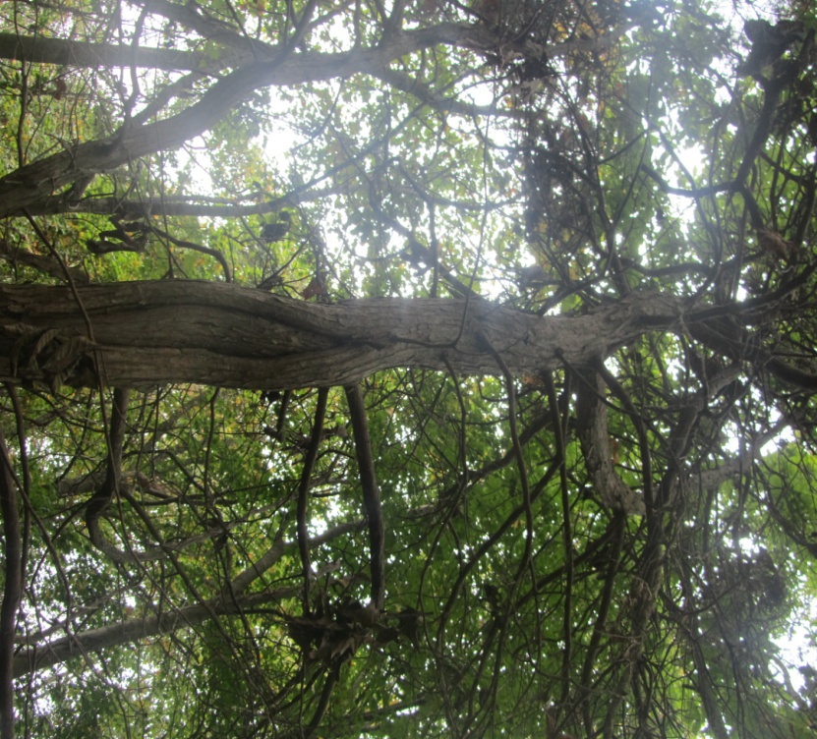
Ecological Succession
These are pictures of ecological succession. On the right, there is a picture of a dead tree. This tree is NOT part of the climax community. It made it possible for the climax community to grow, but made the environment inhospitable for itself.
The other picture is an example of the slow change from pioneer organisms to the climax community. The grasses give way to shrubs, the shrubs to bushes, bushes to small trees, and small trees to larger, older trees.

Slide 5
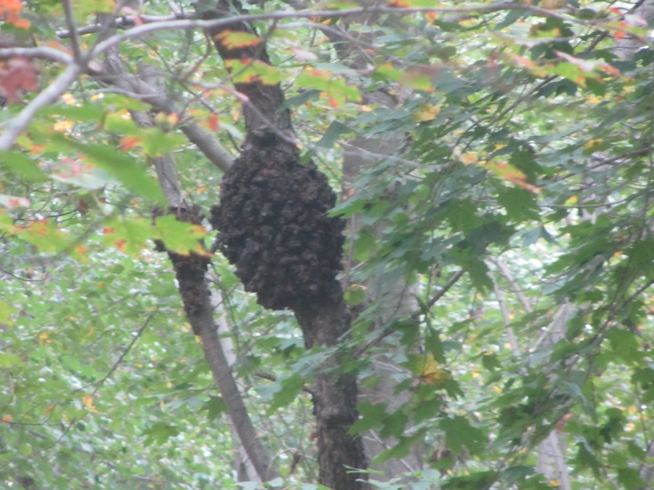
Parasitism
These are examples of parasitism. The fungus (top) is feeding off of the tree’s resources. The growth on the black cherry tree (bottom) is also feeding of the tree’s resources. Note: neither will kill the trees.

Slide 6
Commensalism
This is commensalism. The moss needs a cool, damp, shady spot to grow. The soil and shade around the tree allows the moss to grow. The tree is completely unaffected.

Slide 7
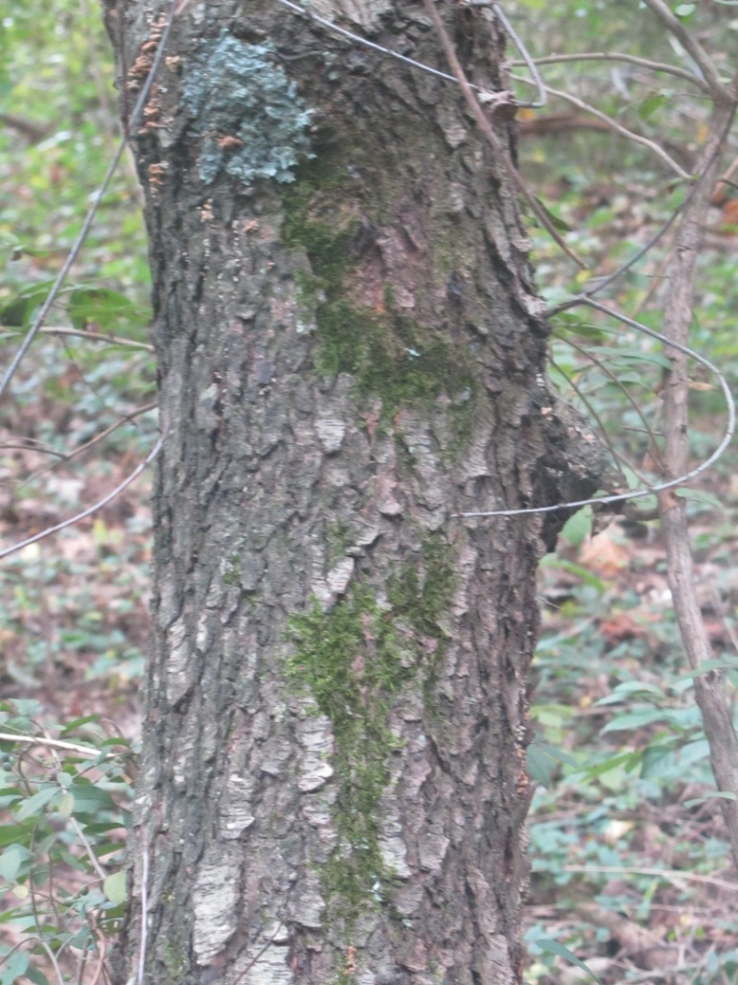
Mutualism
These are examples of mutualism. Lichens are made of algae and fungus. The fungus provides a hospitable habitat for the algae and the algae provides food for the fungus.

Slide 8
Forests
It was very peaceful and beautiful in the woods. The serenity and beauty of nature was such a wonderful change to the deafening riot of normal school. It was so wonderful for all of us. I hope we can all just appreciate and love nature, so we can convince others and ourselves to preserve and protect it.

Slide 9
☺ THANKYOU! ☺

