Slide 1
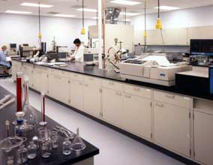
The Organization
of a
Crime Laboratory

Slide 2
Four main reasons:
1 – Increase in crime rates
2 – Increase in drug related arrests
(require chemical analysis for prosecution)
3 – Introduction of the Miranda Law
(decline in use of confessions)
4 – Supreme Court emphasis on the need for scientific evidence in successful prosecution of cases
Approximately 320 public crime labs currently operate at various levels of government.
Number of labs has tripled since 1966.
Why?

Slide 3
Four Major
Federal Crime Labs
Provide expertise in investigative matters to local agencies upon request.

Slide 4
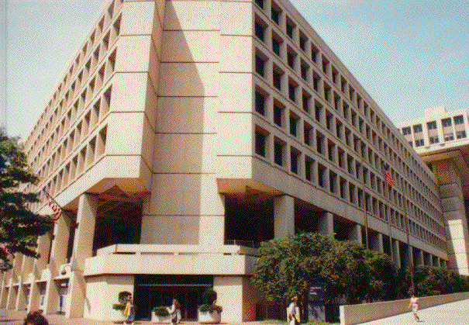
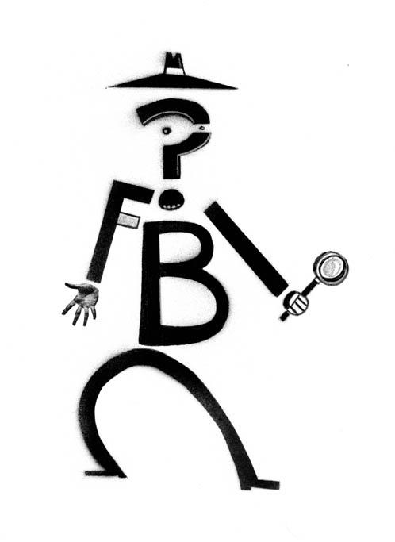
The Federal Bureau of Investigation
Associated with the Dept. of Justice – Has the largest crime lab in the world.

Slide 5
Analyzes drugs seized in violation of federal laws.

Slide 6
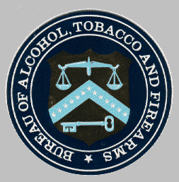
Associated with the Dept. of Treasury.
Analyzes:
Alcoholic beverages
Documents relating to tax law
Weapons and explosive devices

Slide 7
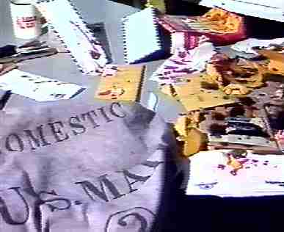
Crime Lab
Deals with investigations relating to the postal service, i.e. letter bombs, questioned documents, etc.

Slide 8
Services of the Crime Lab
Can vary in different communities due to:
Variations in local laws.
Different capabilities and functions of the organization to which the lab is attached.
Budgetary and staffing limitations

Slide 9
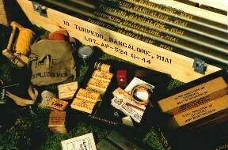
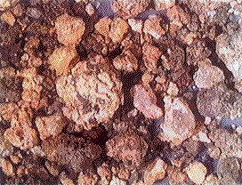
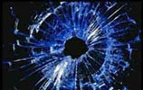
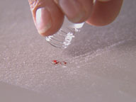
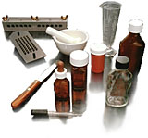
Physical Science Unit
Applies principles of chemistry, physics, and geology to the identification and comparison of crime-scene evidence.
Examines drugs, glass, paint, explosives, and soil.

Slide 10
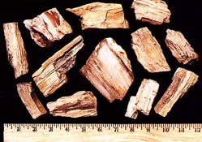
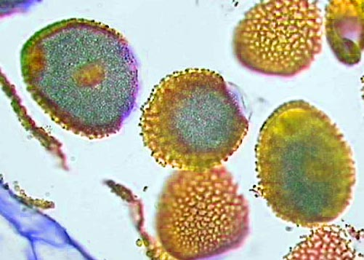
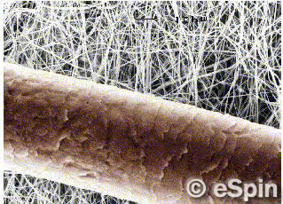
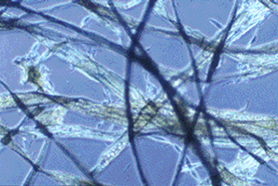
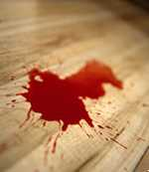
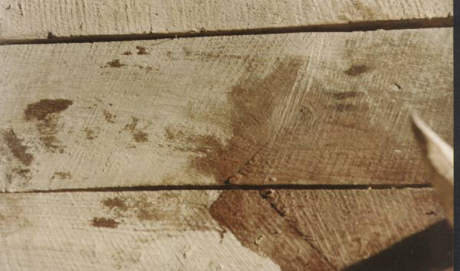
Biology Unit
Applies principles of biology to examine, compare, and identify: bloodstains, bodily fluids, hairs, fibers and botanical materials.

Slide 11
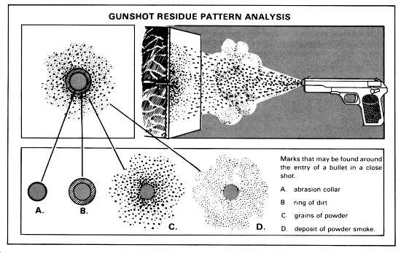
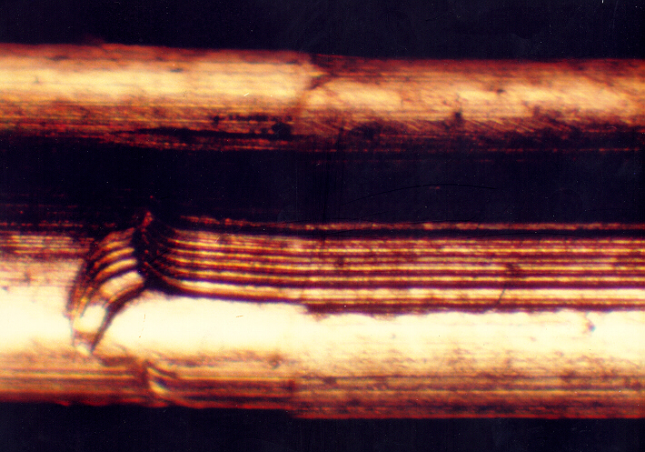
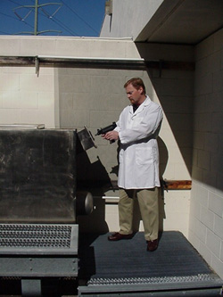
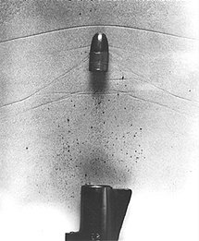
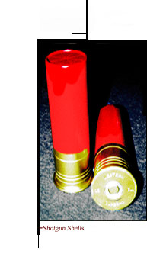
Firearms Unit
Tests firearms, discharged bullets, cartridge cases, shotgun shells, and ammunition. Analyzes tool marks
Examines garments and other objects to detect firearm discharge residues.

Slide 12
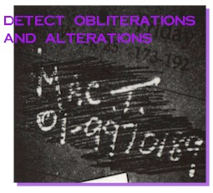
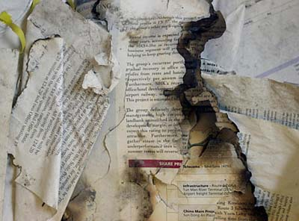
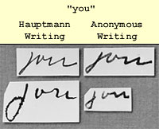
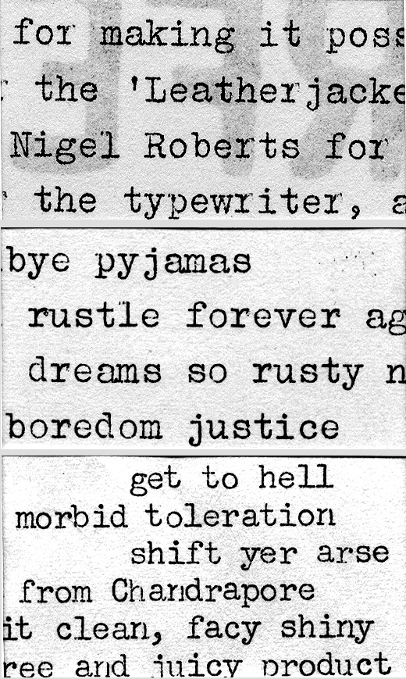
Document Examination Unit
Studies handwriting and typewriting on documents to ascertain authenticity and/or source.
Analyzes indented writing, erasures, and burned or charred documents.

Slide 13
Optional Crime Lab Services

Slide 14
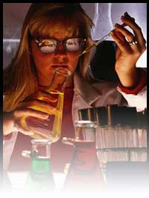
Toxicology Unit
Associated with medical examiner or coroner’s office. Examines body fluids and organs for the presence of drugs and poison.

Slide 15
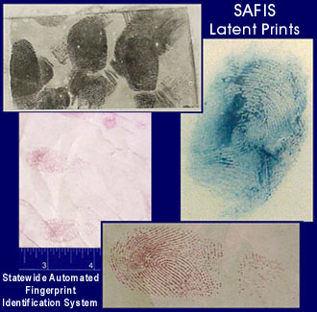
Latent Fingerprint Unit
Processes and examines evidence for latent fingerprints.

Slide 16
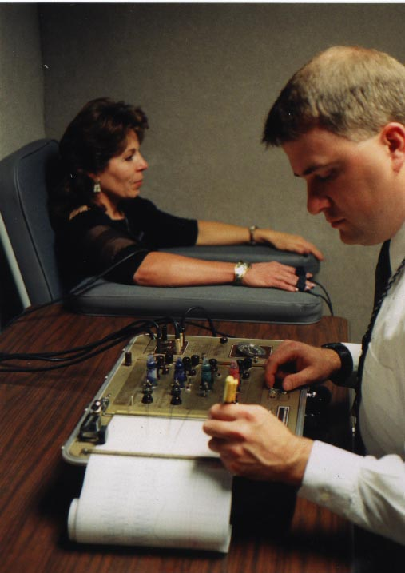
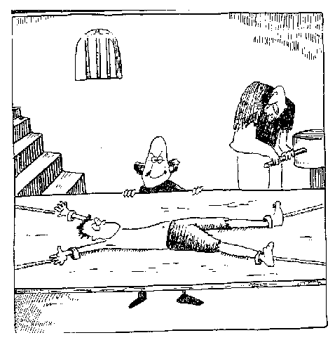
Polygraph Unit
Trained personnel utilize the polygraph or lie detector.

Slide 17
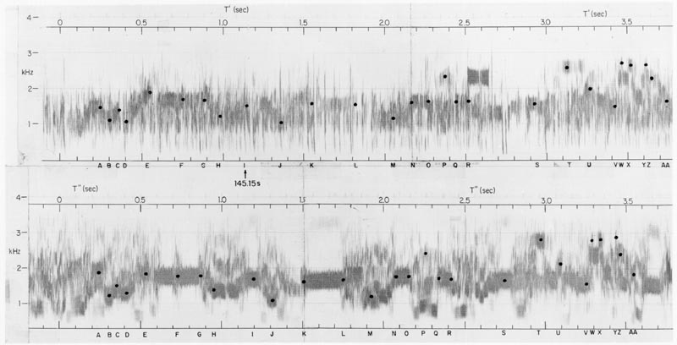
Voiceprint Analysis Unit
Analyses telephoned and tape-recorded messages with instruments that transform speech into visual graphic displays called voiceprints.

Slide 18
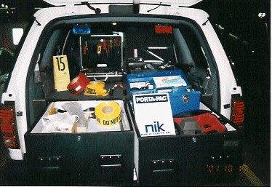
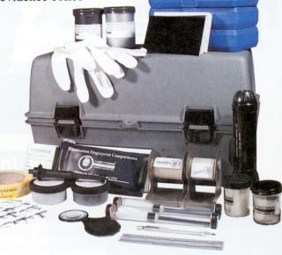
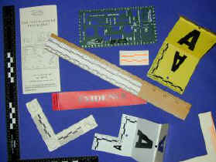
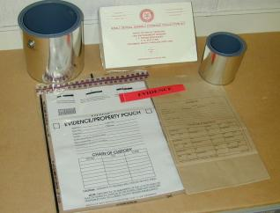
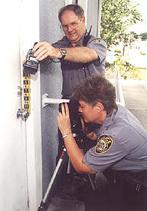
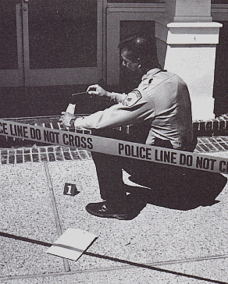
Evidence Collection Unit
Specialized units that collect evidence at crime scenes in order to keep the evidence in its best condition for forensic analysis at the lab.

