Slide 1
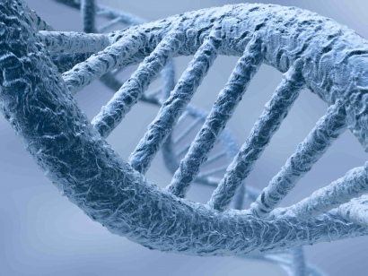
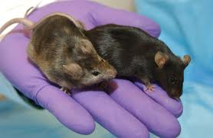
Transgenic Animals!
By Christopher Caldas,
Charlotte Campbell
Gus Kasper

Slide 2
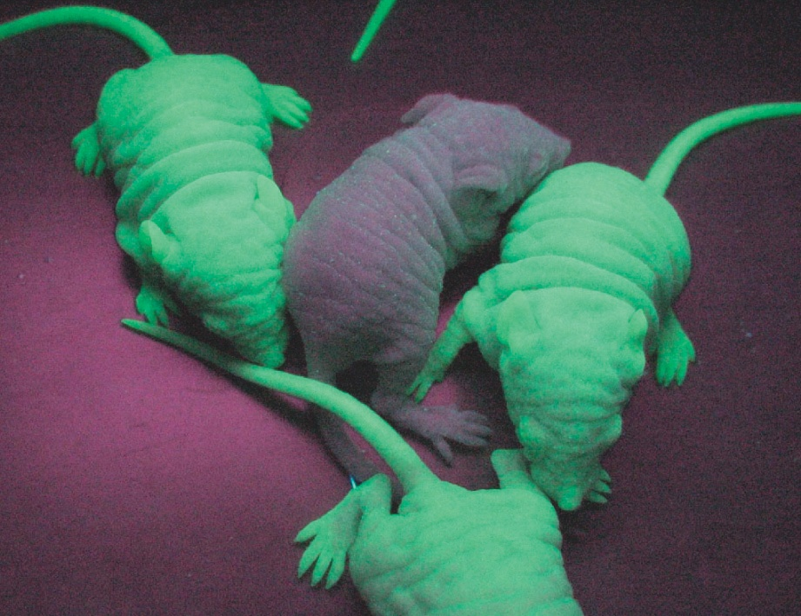
What is a transgenic animal?
A transgenic animal is an organism that contains some DNA of another species
http://video.nationalgeographic.com/video/national-geographic-channel/all-videos/av-5042-5242/ngc-transgenic-animal-creations/

Slide 3
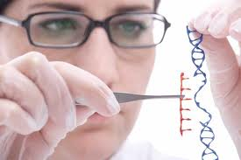
How is a transgenic animal made?
A transgenic animal is made by replacing or adding of a transgene, or by removing one of the animal’s own genes.

Slide 4
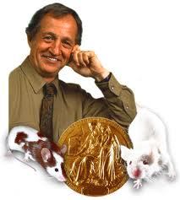
What is a knockout mouse?
A knockout mouse is a mouse who has had one of its genes either inactivated or altered by an artificial piece of DNA!
This often causes a change in the mouse’s Phenotype!

Slide 5
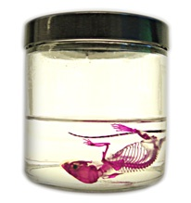
Knockout mice could be very beneficial to us to us
IF we can replace a normal gene with a mutated one, could that go the other way around? Meaning could we fix mutations
This work in gene targeting has taught us about how the body builds and rebuilds itself.
Could tell us about disease, from cancer to obesity.

Slide 6
Advantages of Transgenic animals
Transgenic animals can be made hardly harming the animals, while immensely helping the scientific community
Transgenic animals have been used to be models for various diseases, such as Alzheimer's, some forms of cancer, and sickle cell anemia.
Xenoplanters, organ transplants from transgenic animals, have the potential to save human lives in need of organs.

Slide 7
Disadvantages of Transgenic animals.
Widespread interest in producing transgenic organism it balance by concern over ecological hazards, such as species extinction if such organisms were to be released into nature.
The transgenic animal could suffer greatly, yet not help the scientific community, causing a risk in creating transgenic organisms.

Slide 8
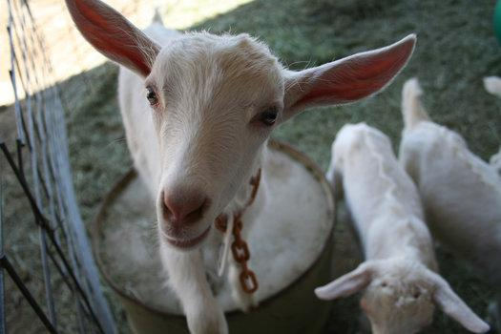
Spider Goat
The gene to produce silk was spliced into this goat’s DNA
We use this silk to create bullet proof vests, artificial tendons, and clothing

Slide 9
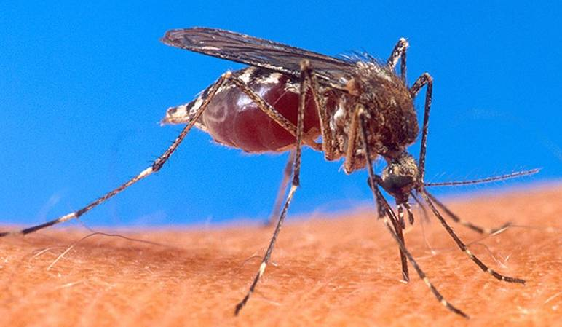
Aedes Mosquito
Mosquitoes carry many diseases (including dengue fever which has no cure or vaccine)
The Aedes mosquitoes are infertile male mosquitoes that will be released into third world countries where these diseases are most prevalent to reduce the mosquito population drastically

Slide 10
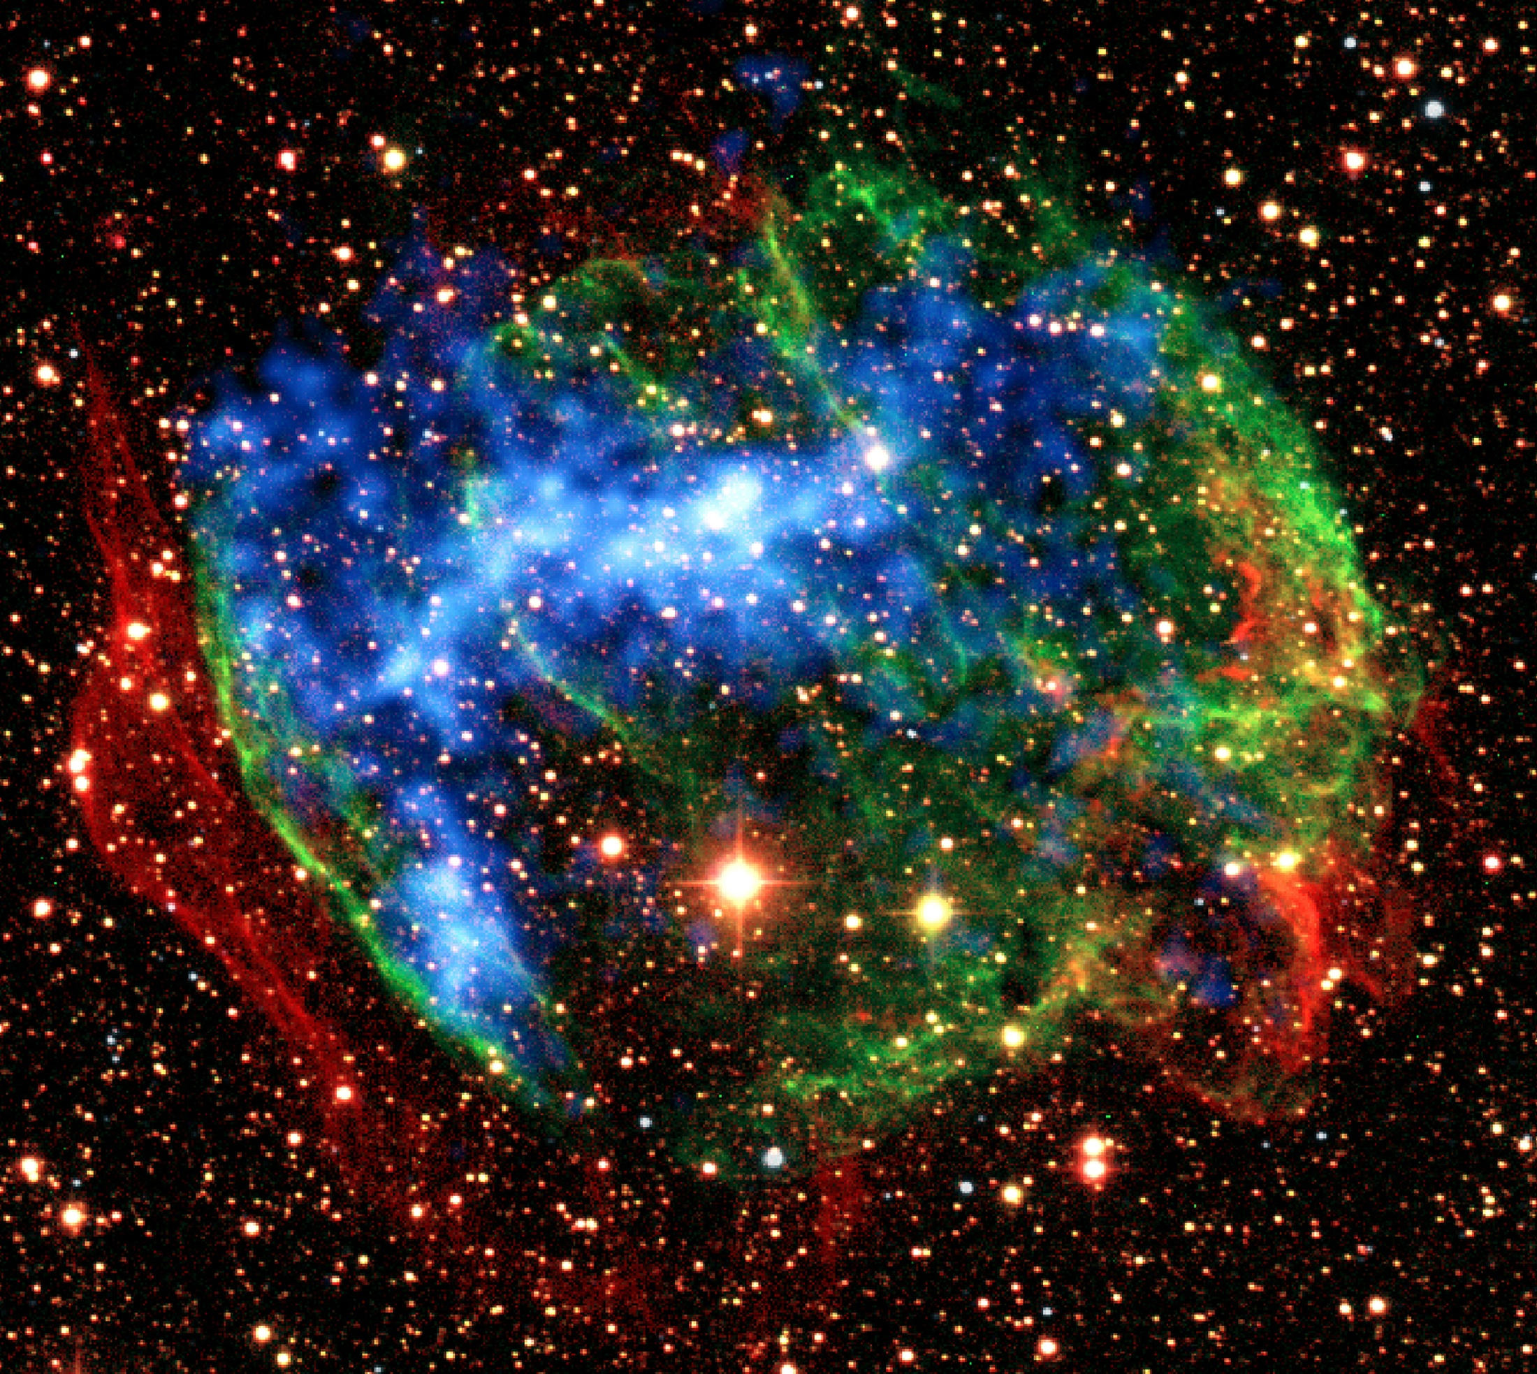
In Conclusion
Transgenic animals are animals that have had their DNA altered by scientists. Also, they could be very beneficial to mankind because they could help us find cures of genetic diseases.
We believe that transgenic animals are extremely beneficial to the human race as a whole.

Slide 11
Work Cited
http://learn.genetics.utah.edu/search/
http://learn.genetics.utah.edu/archive/pharming/index.html
http://learn.genetics.utah.edu/content/tech/transgenic/
http://www.genome.gov/12514551
http://learn.genetics.edu/archive/pharming/index.html
http://learn.genetics.utah.edu/content/tech/transgenic/
http://dsc.discovery.com/technology/tech-10/genetic-engineering/10-transgenic-animals-03.html
http://www.popsci.com/science/gallery/2010-11/how-scientists-are-messing-animals?image=2
http://dsc.discovery.com/technology/tech-10/genetic-engineering/10-transgenic-animals-07.html

