Slide 1
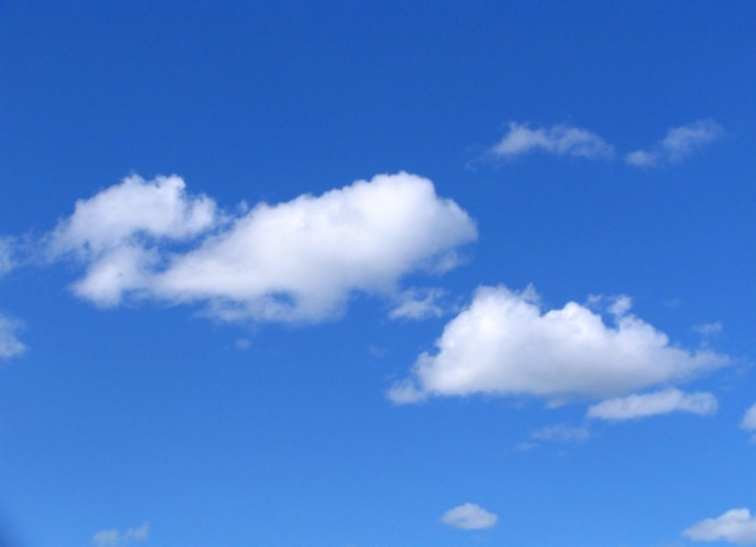
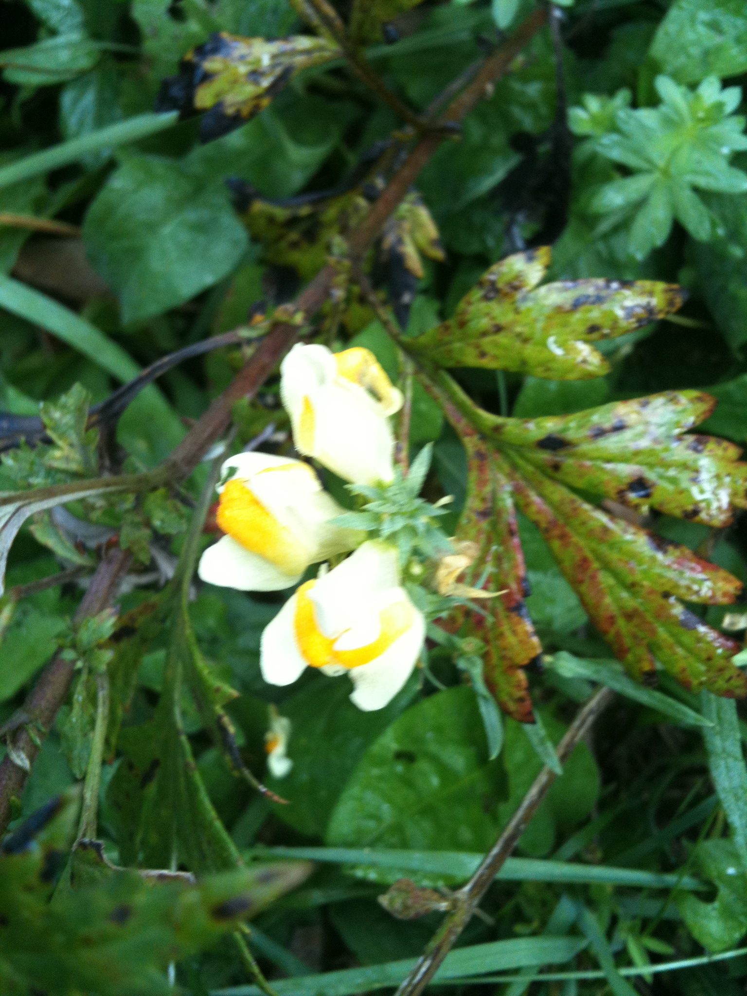
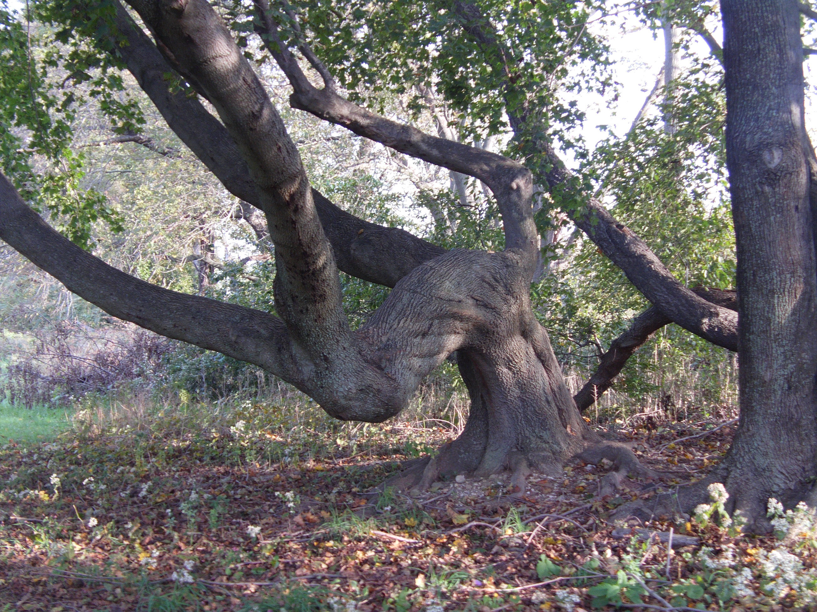
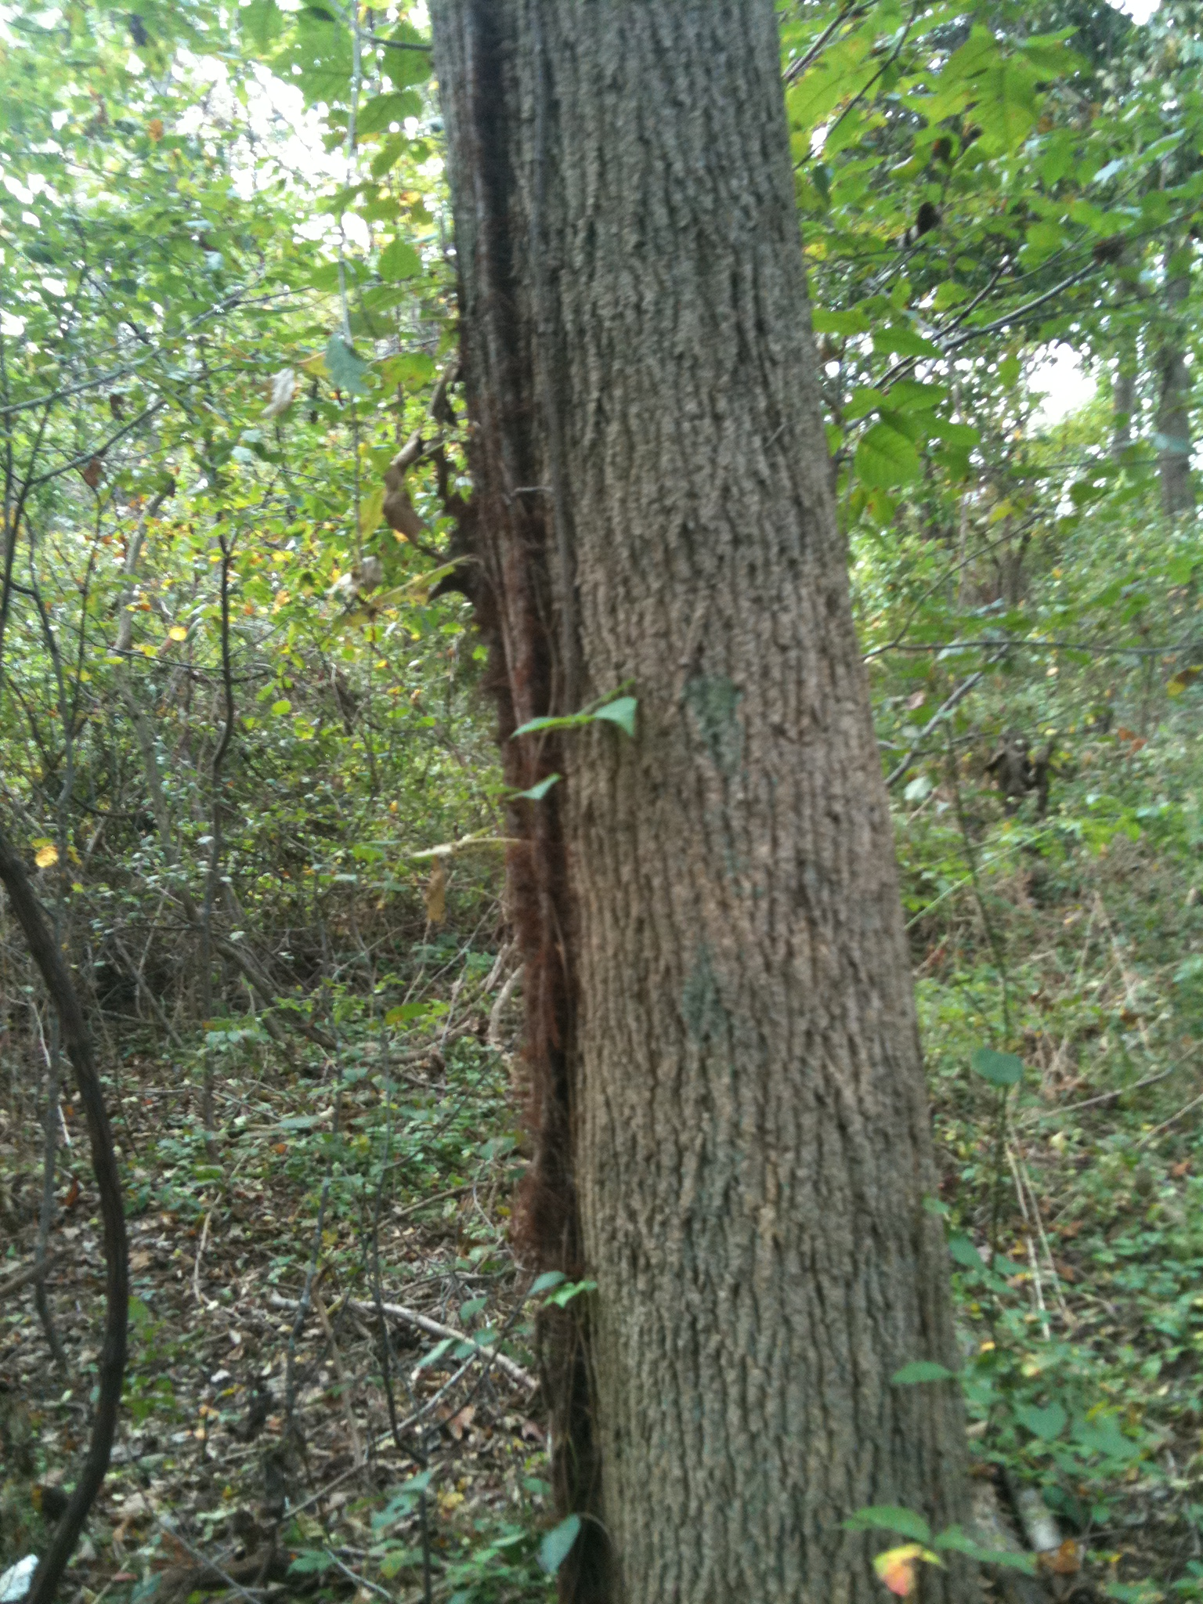
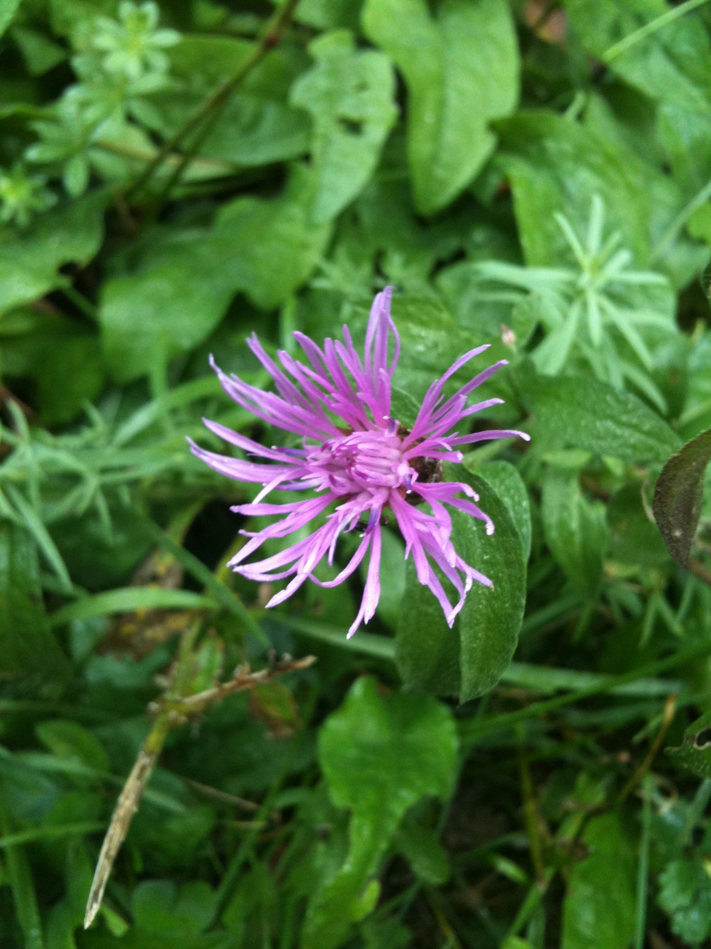
Our Nature Journal
Baked Butter and Eggs
Phototropism
By Michaella and Sarah
Poison Ivy vine on tree
Oyster Plant

Slide 2
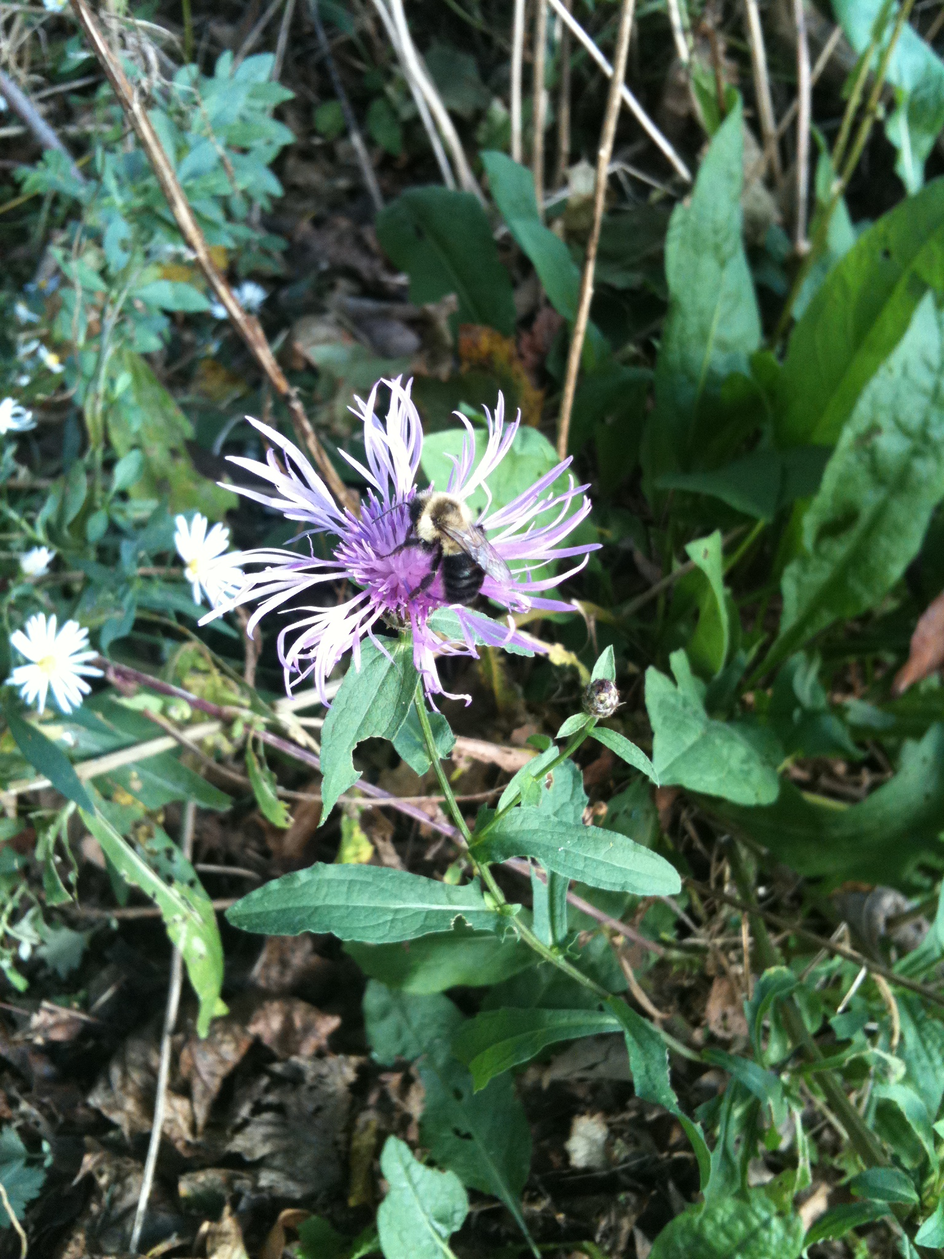
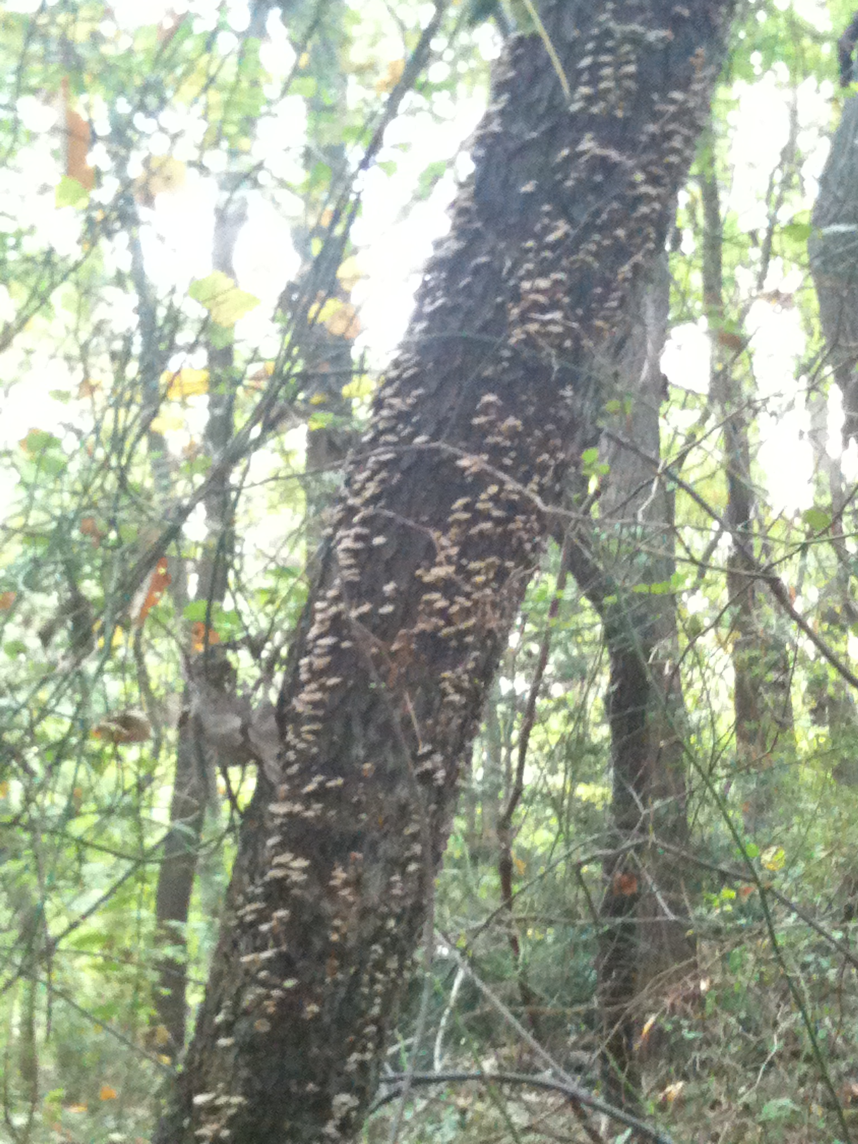
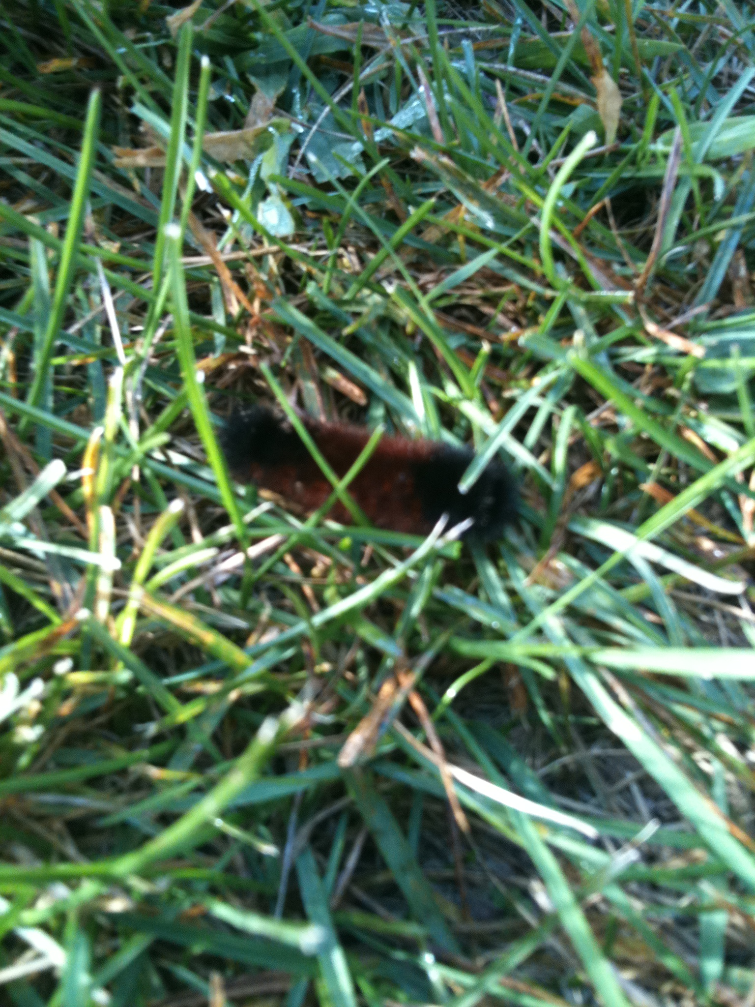
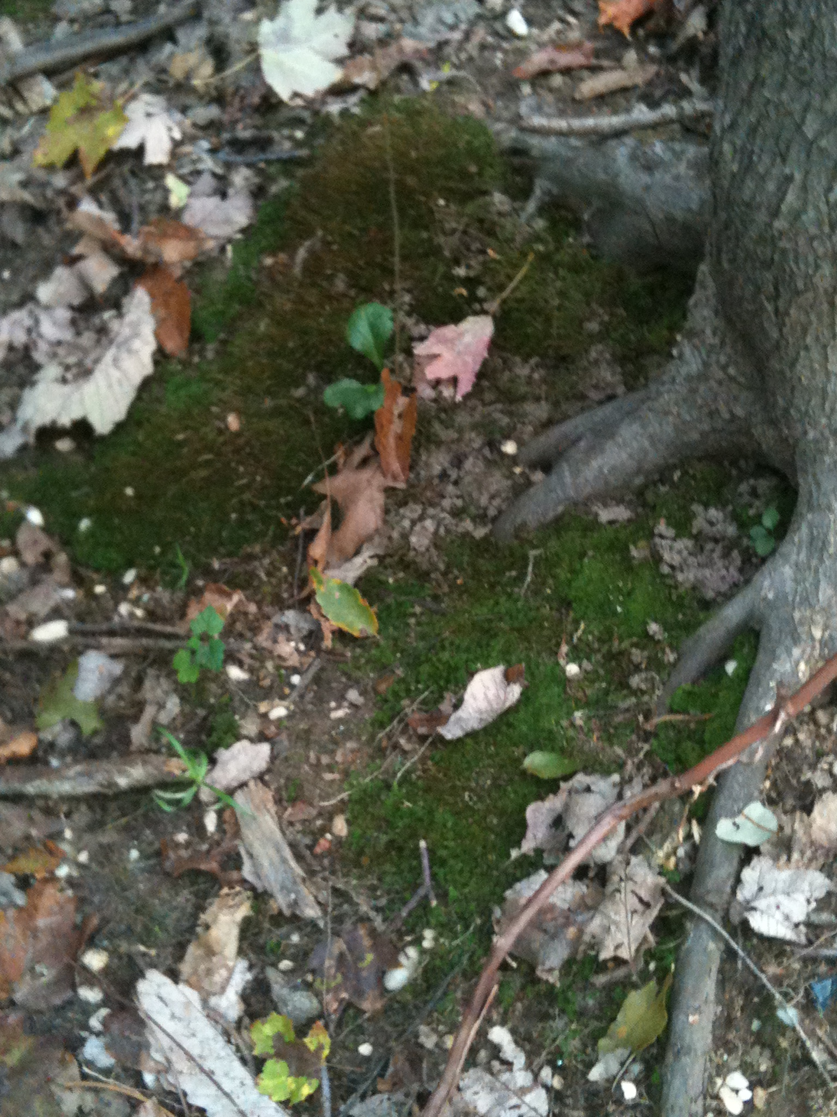
Nutritional Relationships & Material Cycling
Nutritional Relationships
Bee and Flower
Wooly Bear Caterpillar and Cricket
Materials Cycling
Fungus
Lichen
Bee and Flower
Fungus on Tree
Wooly Bear Caterpillar
Moss

Slide 3
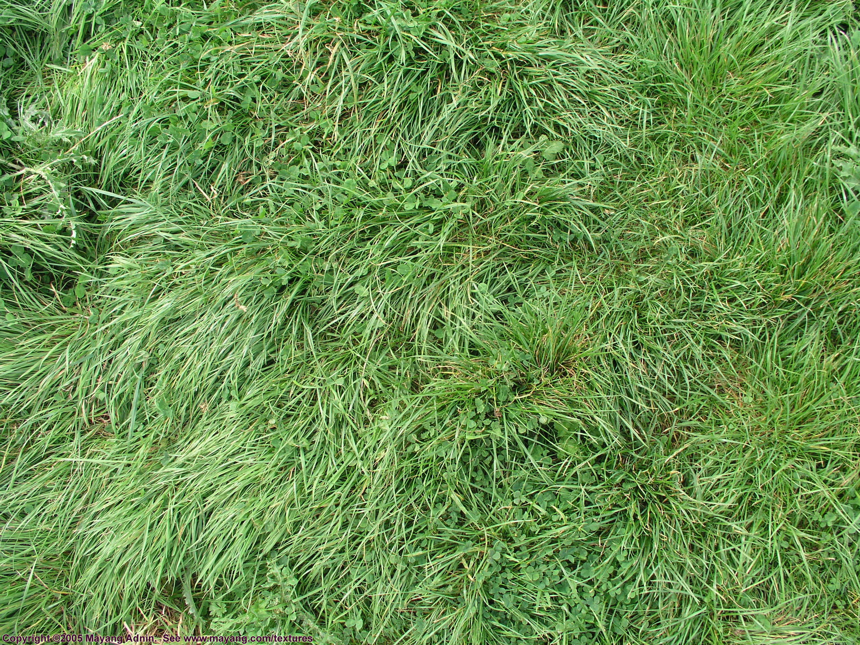
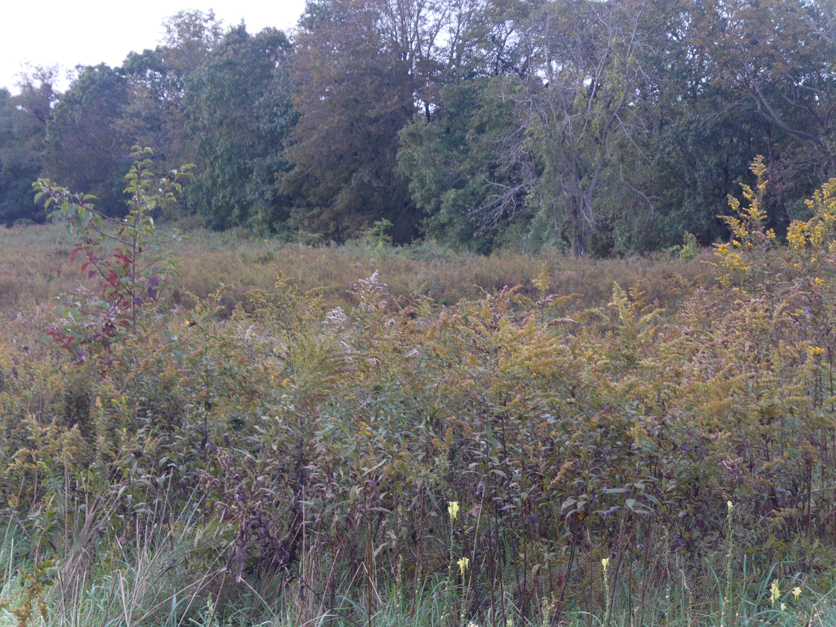
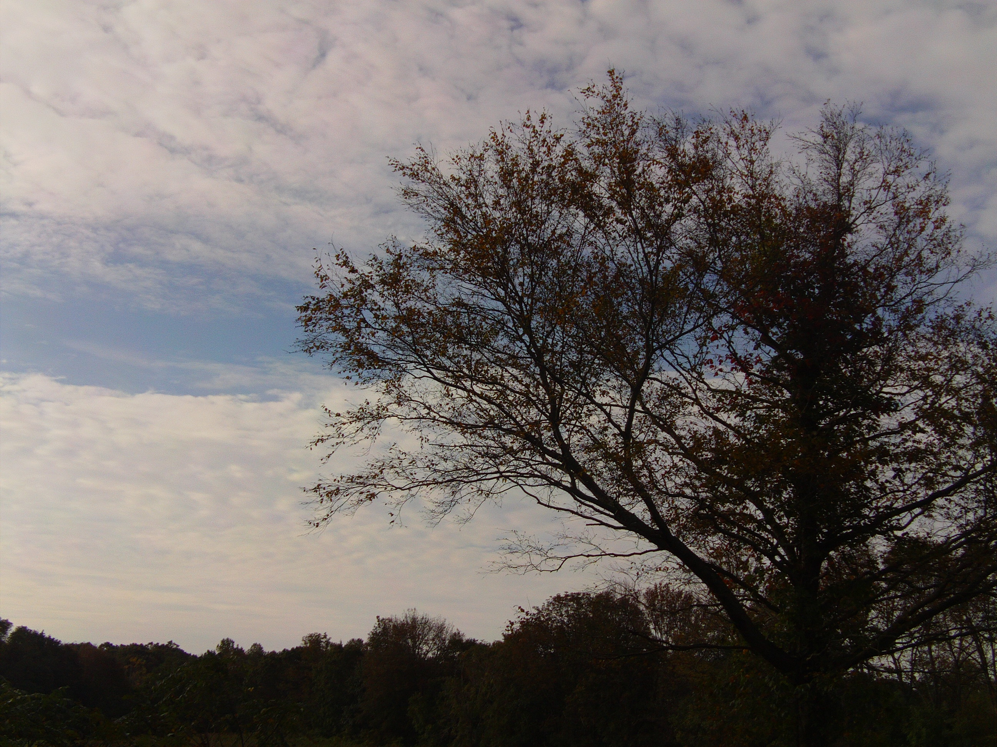
Ecological Succession
If grass is not tended, tall grass, shrubs, and eventually trees will grow in its place.
Short Grass
Tall Grass and Shrubs
Trees
1
2
3

Slide 4
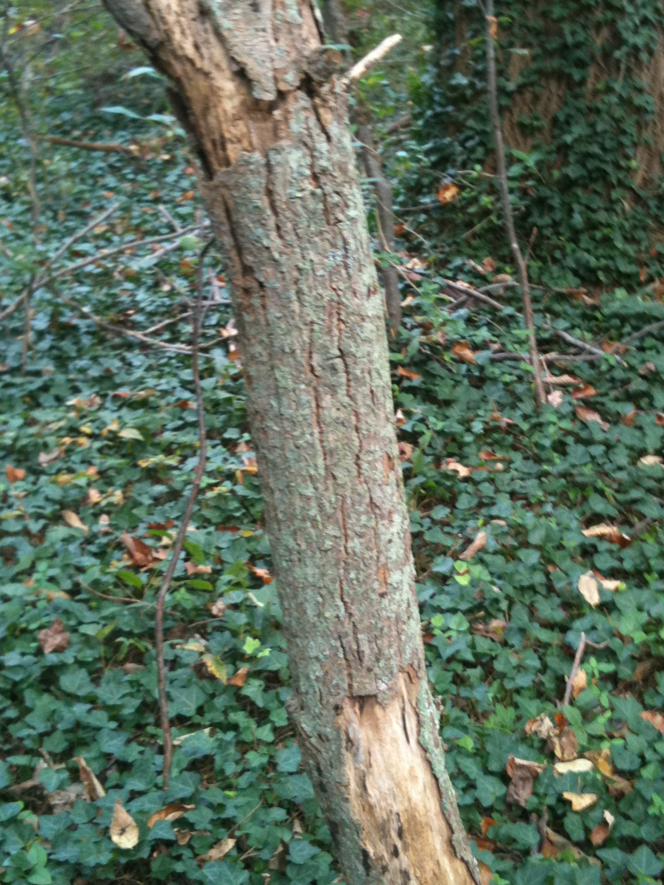
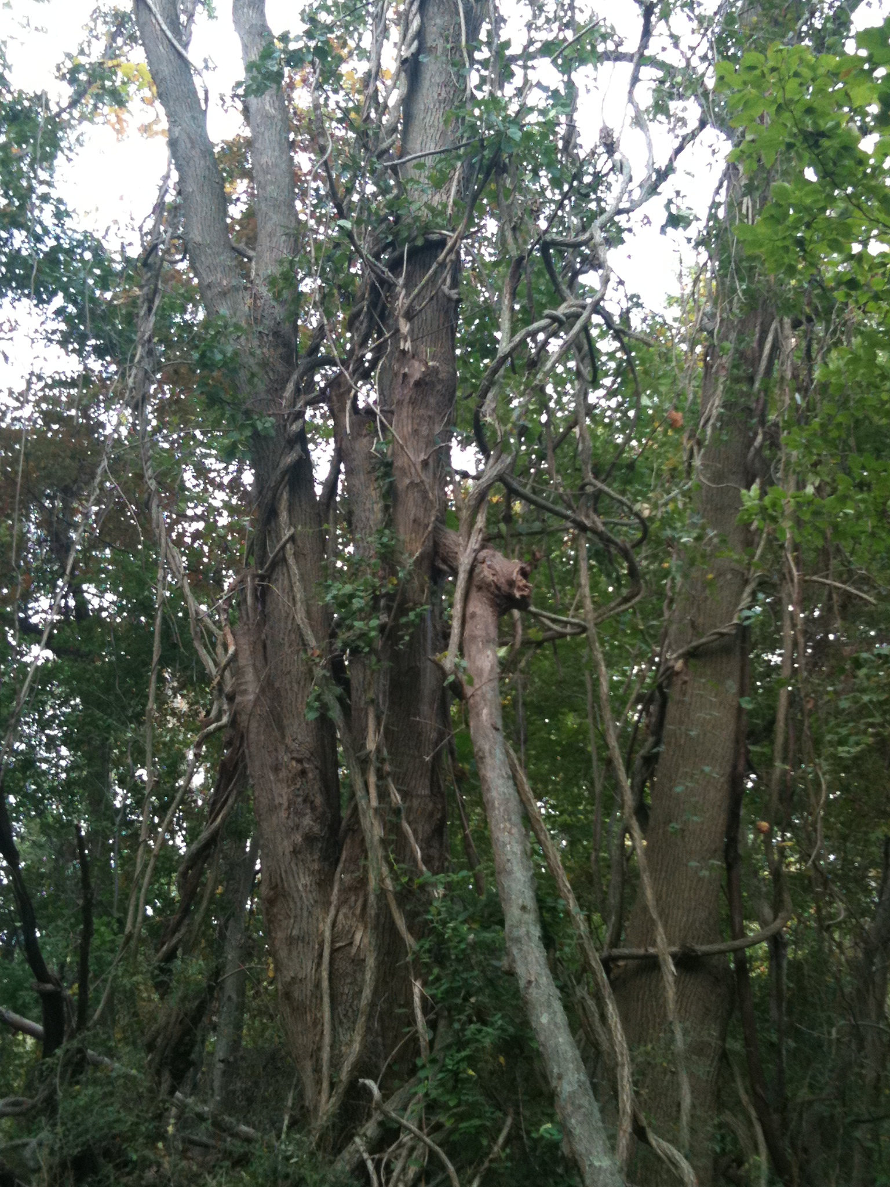
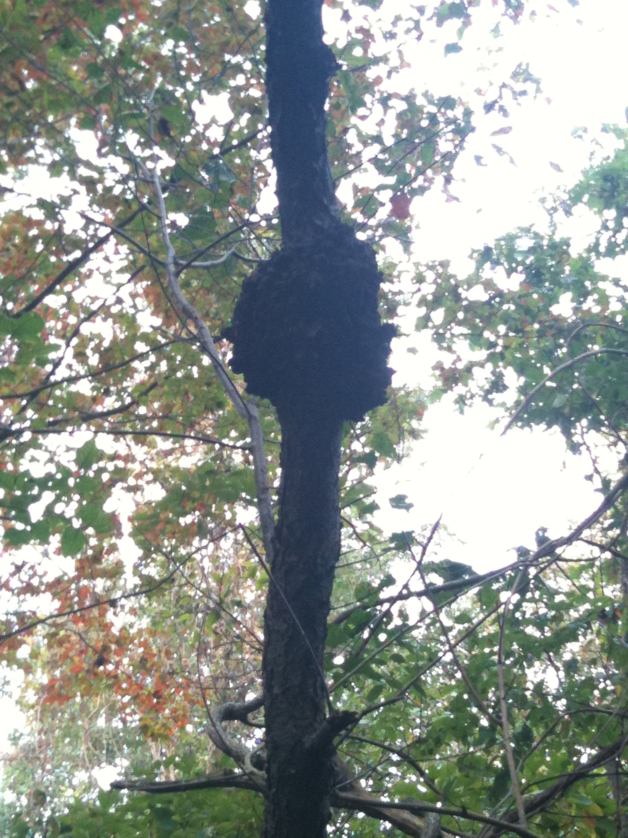
Symbiosis
Mutualism
Lichen (fungus and algae) on trees
Parasitism
Vine and tree
Commensalism
Black Cherry Tree and Bacterium
Lichen on tree
Vines and Trees
Black Cherry Tree and Bacterium

Slide 5
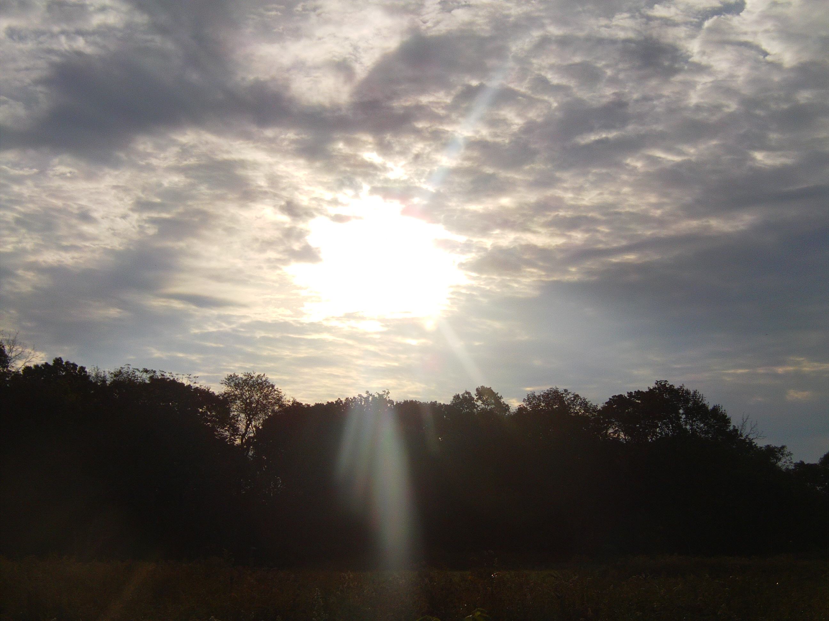
Reflective Writing~Haikus
1) Went on a field trip
Saw lots of plants and some birds
Of different species.
2) Baked Butter and Eggs
Oyster Plants and and Golden Rods
Sassafras, Sumacs
3) Things are all around
Bee and Birds and Butterflies
Flying all about

