Slide 1
Some verbs have a stem change in the ___________________________.
In the following verbs, the ______ changes to an ______.
These verbs are just like the other __________________________ we have studied! ☺
present tense
e
i
stem changing verbs

Slide 2
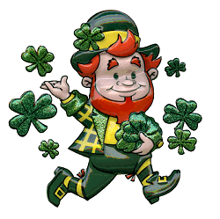

Slide 3
Pedir (to )
ask for/ order
Yo |  |  | nosotros(as)
tú |  |  | Vosotros | Pedís | You two ask for/order
Él, ella, Ud. |  |  | Ustedes, ellos, ellas
pido
I order
pedimos
we order
You (informal) order
pides
He, she,
you (formal)
order
you all,
they order
pide
piden

Slide 5
1. I order the salad. __________________________________________
2. You (informal) ask for the check/bill. __________________________________________
3. Diego and I order steak. __________________________________________
Yo pido la ensalada.
Tú pides la cuenta.
Diego y yo pedimos bistec.

Slide 7
Servir (to )
serve
Yo |  |  | nosotros(as)
tú |  |  | Vosotros | servís | You two serve
Él, ella, Ud. |  |  | Ustedes, ellos, ellas
sirvo
I serve
servimos
we serve
You (informal) serve
sirves
He, she,
you (formal)
serve
you all,
they serve
sirve
sirven

Slide 9
1. My mom serves the food. __________________________________________
2. The waiters serve the bread.
__________________________________________
3. We serve the breakfast. __________________________________________
Mi madre sirve la comida.
Los meseros sirven el pan.
Nosotros servimos el desayuno.

Slide 10
