Slide 1
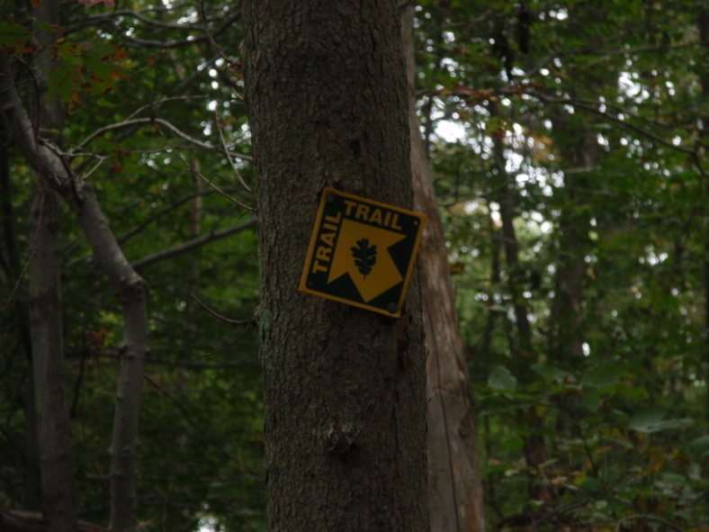
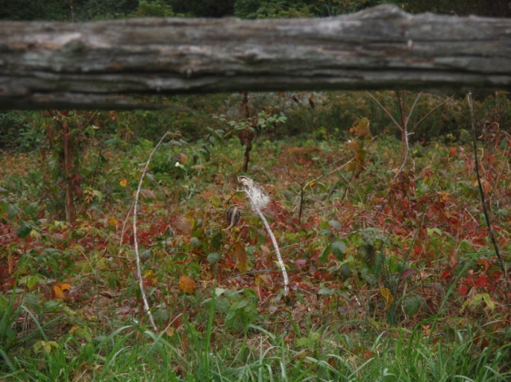
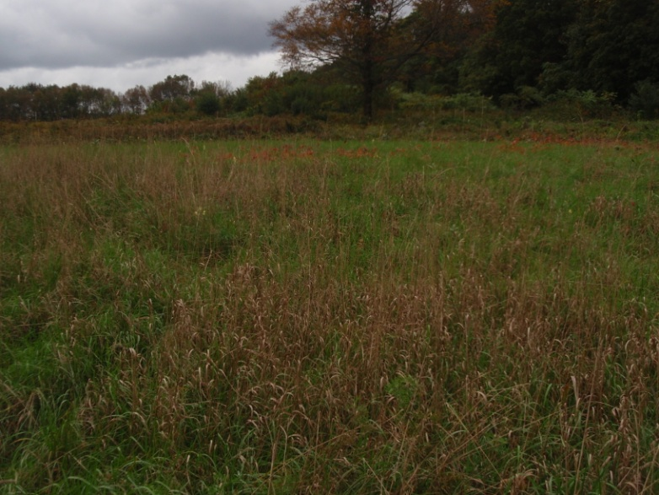
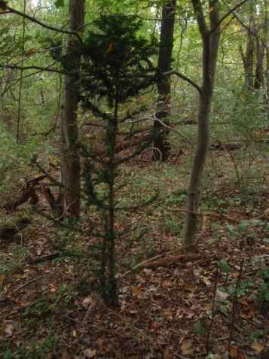
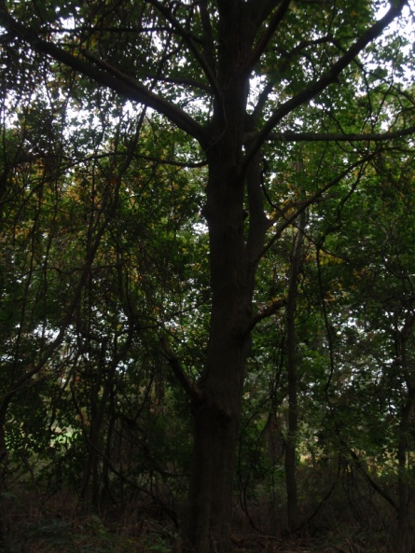
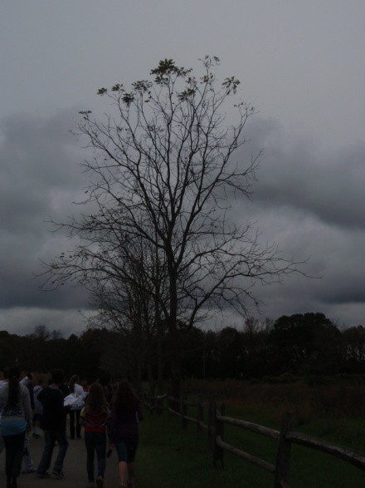
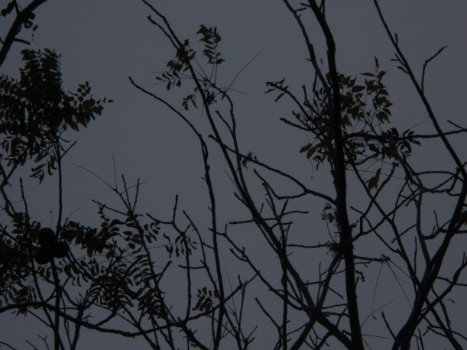
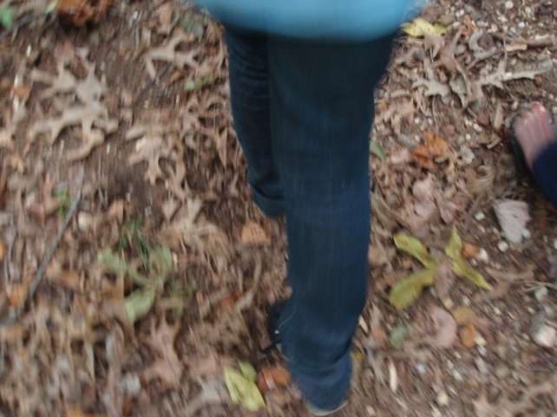
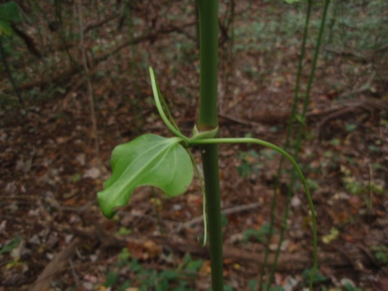
Nature Journal From the Uplands Nature Conservancy
By Martine Brechter, Ariela Minkovsky, and Danielle Popovski

Slide 2
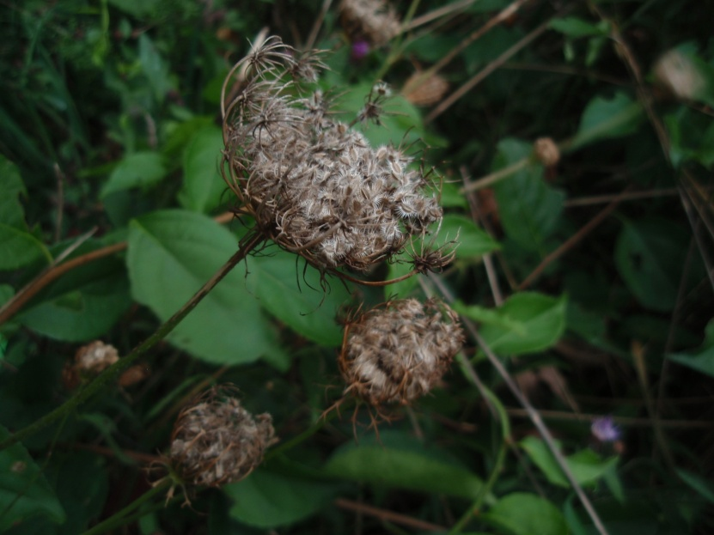
Nutritional Relationships: Queen Anne’s Lace
Though the flowers we
took this picture of were
Dead and grey, Queen Anne’s
lace, also known as the wild
carrot, is white and has a
red dot in the center said to
be from when Queen Anna pricked herself while
sewing lace. It is a producer/autotroph and would
possibly be eaten by the grasshopper or other
insects. Queen Anne’s lace is also invasive;
brought from Europe.

Slide 3
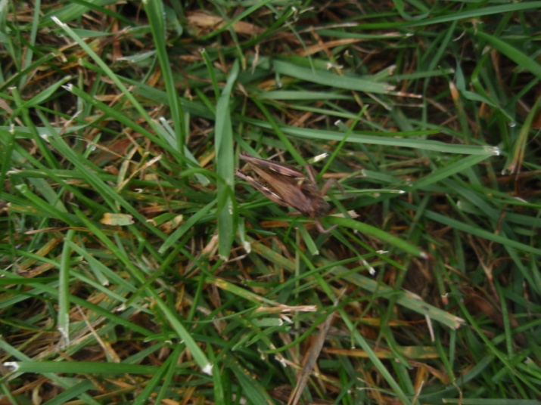
Nutritional Relationships: Grasshopper
This grasshopper is a consumer. Specifically a omnivore. They mostly eat plants but will eat small flies and other small insects. Grasshoppers would be eaten by
birds or preying
mantises. If it wasn’t
eaten during its life
it would broken
down by
decomposers.

Slide 4
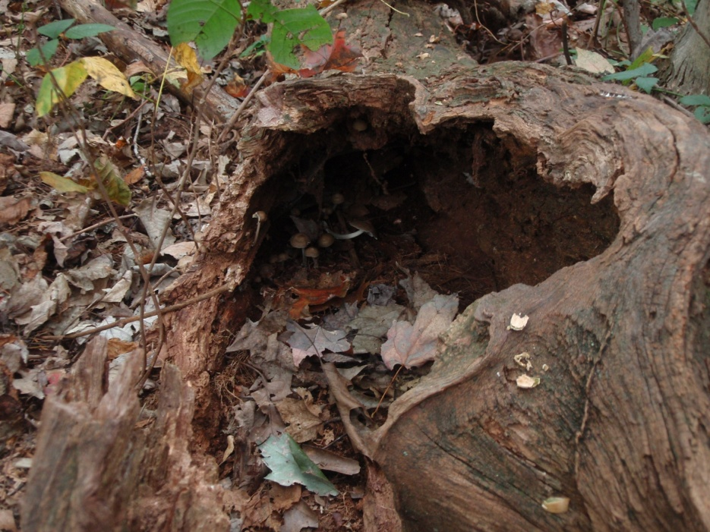
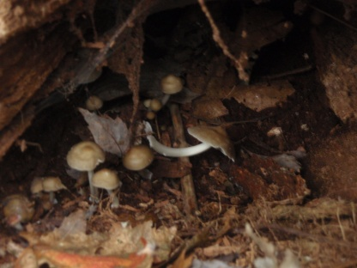
Material recycling: Mushrooms
Mushrooms are decomposers. In this picture they are breaking down a dead tree. Mushrooms help recycle minerals and other nutrients to the earth so they can be used again by other plants.

Slide 5
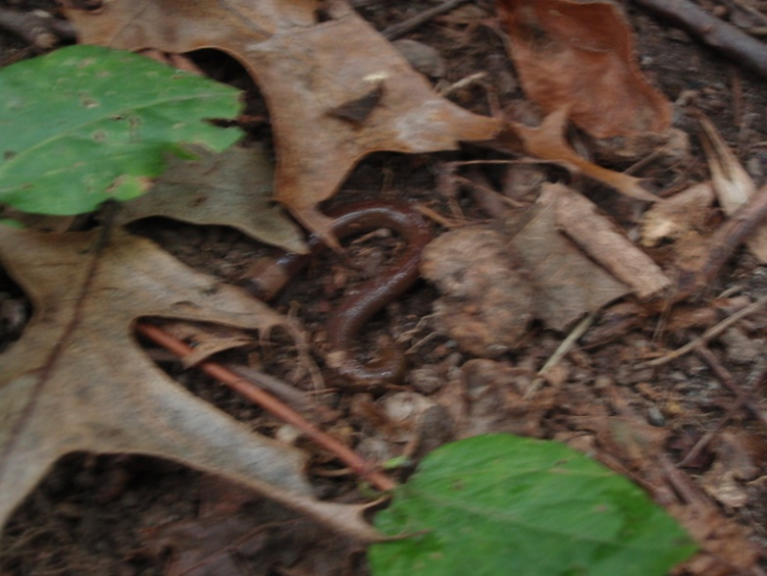
Material Recycling: The Earthworm
The earthworm shown in
this picture is a
decomposer. Earthworms
break down dead
organisms and return their
nutrients to the soil, similarly to the mushrooms.

Slide 6
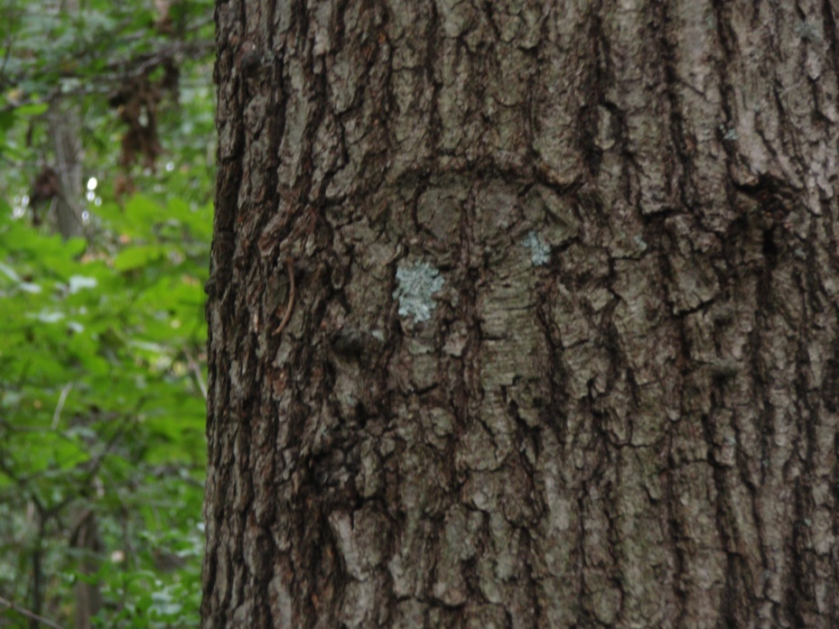
Symbiosis: Lichen
Lichen is a mutualistic relationship between fungi and algae; where the fungus gives the algae a home while the algae provides the fungus with food (glucose made
through
photosynthesis).

Slide 7
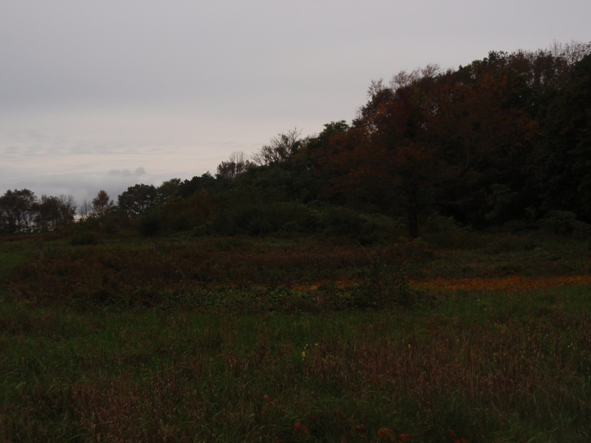
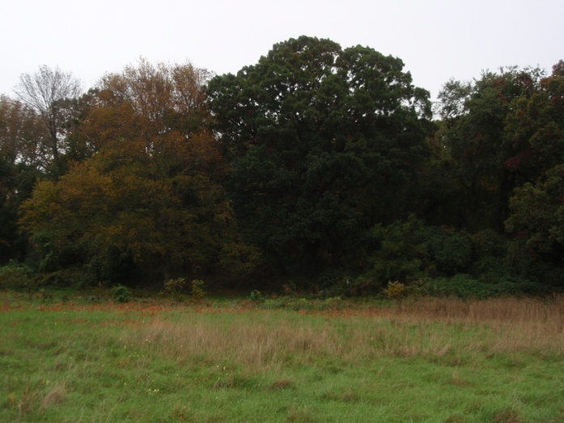
Ecological Succession
Over time moss (the pioneer organism) in this field will break up the soil. When the soil is broken up more, shrubs and bushes will take it’s place and the soil will become even more fertile. Eventually trees will grow in, taking the place of those shrubs; like in the woods surrounding this field.

Slide 8
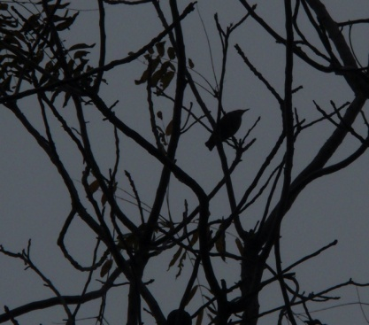
Fun at the Conservancy
When the trees sway in the wind,
And the birds chirp happily,
When taking pictures of Ariela,
Or the ants on the ground,
Though you walk for an hour,
You get so much more,
Learning about Lichen,
Or sparrows,
Or bees,
We are learning with our friends,
And our favorite teacher!

Slide 9
Works Sited:
http://www.fcps.edu/islandcreekes/ecology/queen_annes_lace.htm
http://www.teachersdomain.org/resource/tdc02.sci.life.oate.decompose/

