Slide 1
Weather and Climate

Slide 2
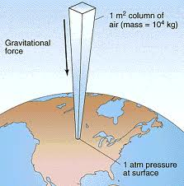
DENSITY
The __________________ of matter in an object
The _____________ of how mass something is divided by how much space it takes up
Formula
Density = __________________/________________
DOES AIR HAVE MASS????

Slide 3
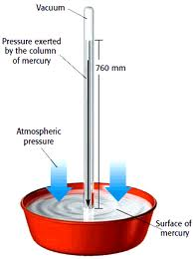
Atmospheric Pressure
Measured by barometer
________________ pressure = really means= how light or heavy
the air is
Low pressure = bad weather (______)
High pressure = nice weather (______)
*wet air is actually lighter than dry air (molecular weight of molecules)
* warm air can hold more water than cold (never “humid” in the winter)

Slide 4
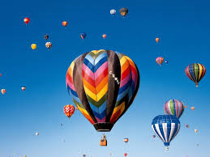
Effect of temperature on Air Pressure
As temperature _____________ pressure _______________
Hot air rises because the air _____________ when it is warmed and becomes less dense.
Hot air balloon

Slide 5
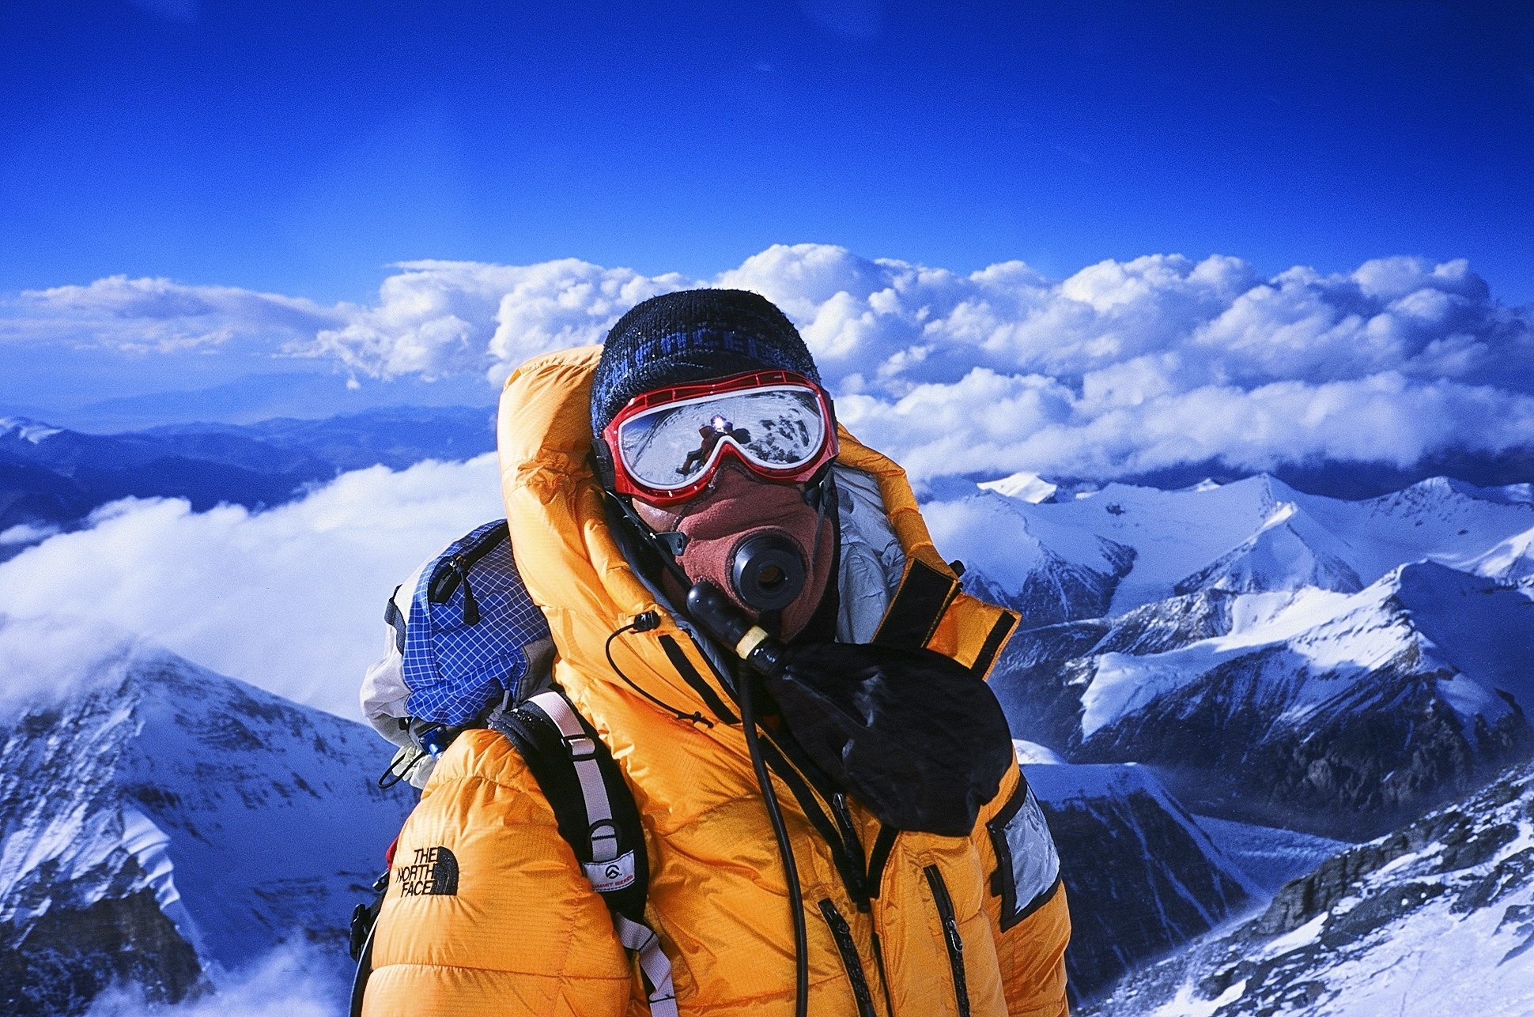
Effect of altitude on air pressure
As you climb higher (go up in a plane, climb a mountain) the air molecules are more spread out/harder to breathe - ___________ _____________
Increase altitude ---decrease pressure

Slide 6
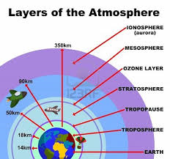
Effect of water vapor on pressure
Wet air is actually less dense than dry air (molecular
weight of elements in air)
As ________ ________increases----___________ decreases
Only layer of atmosphere to have “weather” is the 1st one (troposphere) because it is the only one that has water vapor
(side note – the aurora borealis take place in the IONOSPHERE)

Slide 7
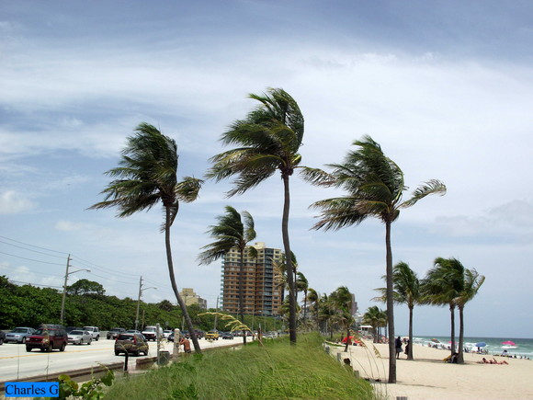
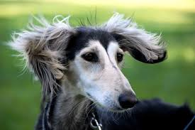
WIND
Always wants to blow from _________ to ________ pressure
The bigger the change in pressure that ___________ the wind speed
Always named for the direction it comes FROM, not where it is going to
Wind speed is measured using a ANEMOMETER

Slide 8
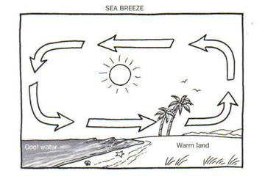
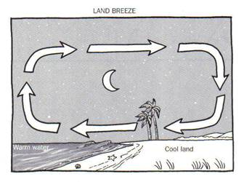
Land breezes VS Sea Breezes

Slide 9
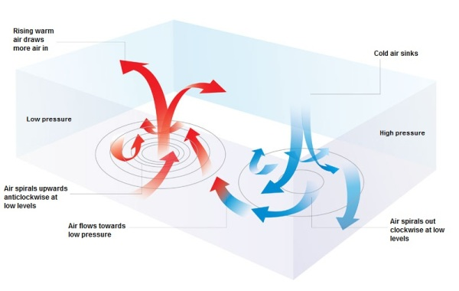
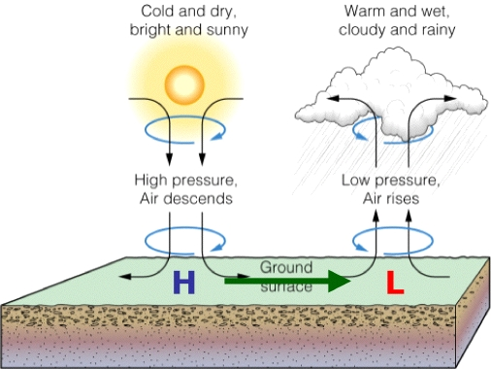
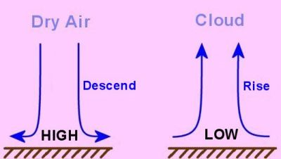
High and Low pressure
Lows (cyclones) – pressure is lowest in the center so therefore winds blow inward
Highs (anticyclones) – pressure is highest in the center so therefore winds blow outward

Slide 10
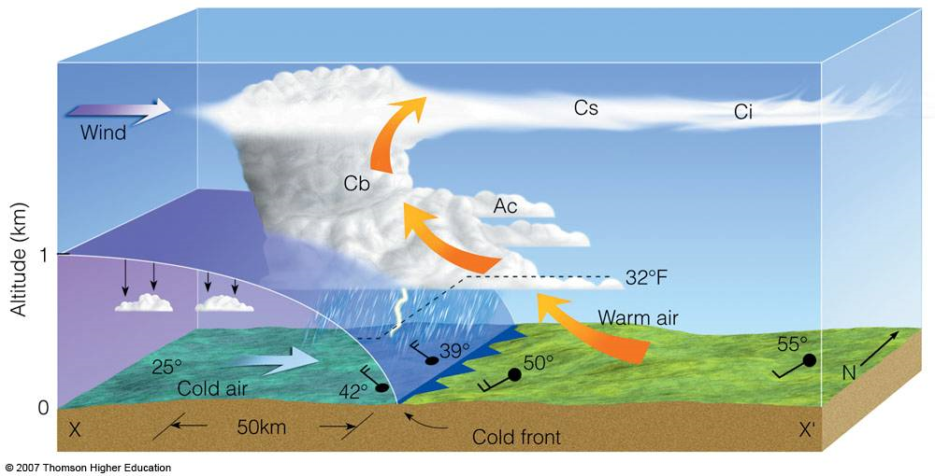
Fronts
Where two air masses of different characteristics meet
Most severe weather (storms) occur because two fronts have met one another
_________ ___________– the boundary of an advancing cold air mass
_________ ___________– the boundary of an advancing warm air mass

Slide 11
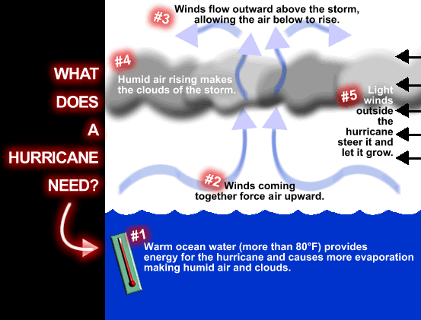
Severe Weather Events
Hurricanes- warm oceans feed heavy winds and cause hurricanes. Winds can cause great damage.
-Must begin at ______________
Thunderstorms-rain clouds build electrical charges and cause electrical currents towards the grounds electrical charge (______________)
Tornadoes- warm, moist air MEETS cool, dry air and cause a collision of air masses which lead to violent wind shifts and ___________ ___________.

Slide 12
Climate (factors)
Latitude
Distance from large body of water
Ocean currents
Mountain ranges
elevation

Slide 13
KEY TERMS
Air pressure
Barometer
Density
Altitude
Atmosphere
Water vapor
Troposphere
Land breeze
Sea breeze
Front
Hurricane
Tornado

