Slide 1
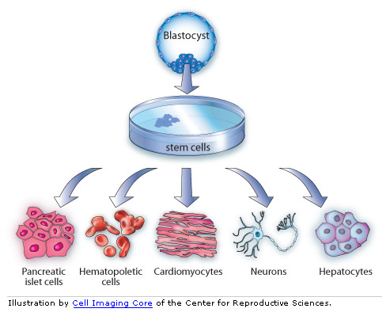
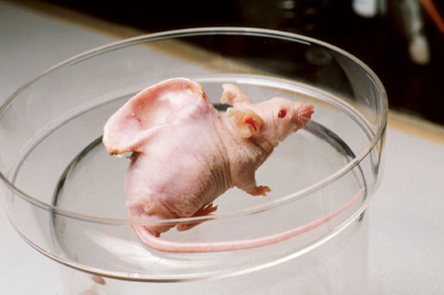
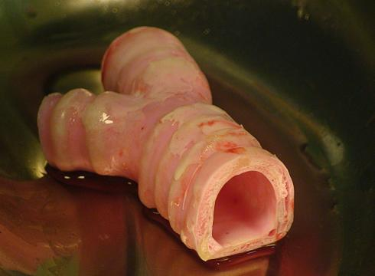
Stem Cells
Aidan Coffey

Slide 2
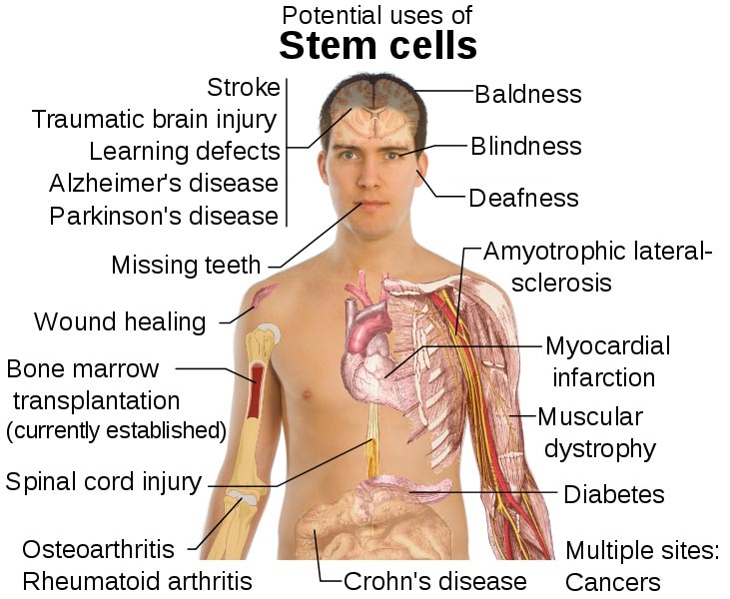
Why Stem Cells?
Stem cells may be the future!
May be the cure to diseases previously incurable, such as cardiovascular disease, diabetes, spinal cord injury, and cancer, Alzheimer’s disease, Lou Gehrig’s disease, Multiple Sclerosis, and Parkinson’s disease, among others.

Slide 3
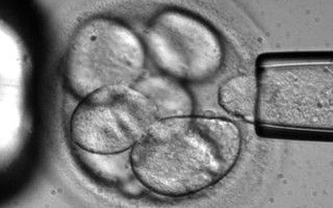
Why Stem Cells?
Have actually been used regularly in veterinary practice since 2003 for the repair of bone and tissue damage.
When cultivated on a Petri dish, can grow into an organ or tissue (depending on the environment)

Slide 4
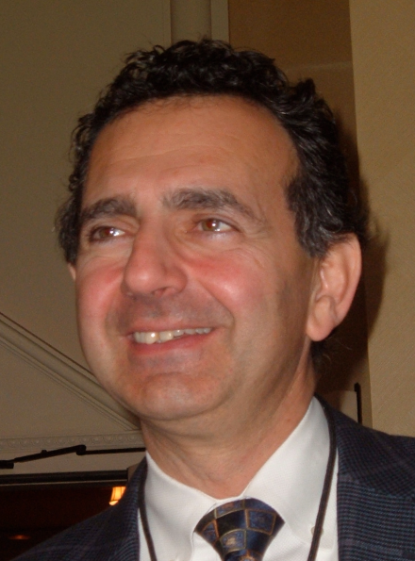
Transplanted organs: The bladder
This technique was developed by Anthony Atala of the Wake Forest Institute for Regenerative Medicine in Winston-Salem, North Carolina
Take healthy cells from the diseased bladder, and then cause them to multiply. Put them into a balloon-shaped scaffold with muscle cells on the outside, urothelial cells (which line the urinary tract) on the inside. Then incubate at body temperature.
Process takes 6-8 weeks

Slide 5
Transplanted organs: The trachea
In 2011 scientists created an artificial trachea that had a spongy and flexible structure
Tracheal cancer: accounts for less than 1% of all cancers
The man who received this trachea was 36. He had tried every other treatment, including chemotherapy, radiation and surgery.

Slide 6
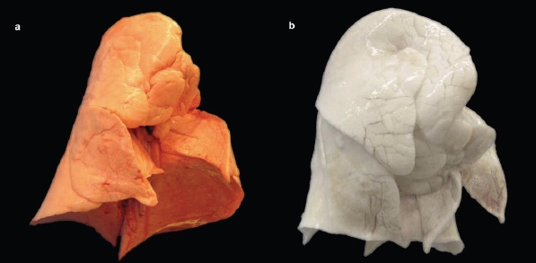
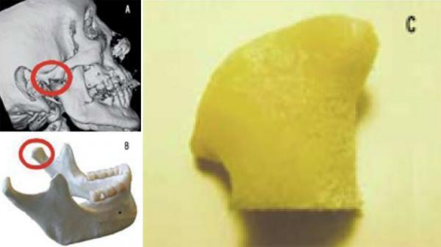
Other organs
These organs have been created, but none have been transplanted
Yale University created a bioartificial lung
Columbia University created a bioartificial jawbone

Slide 7
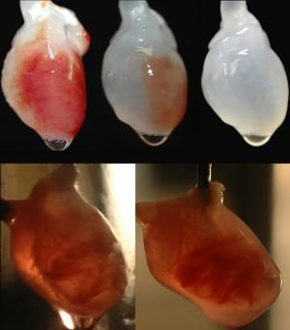
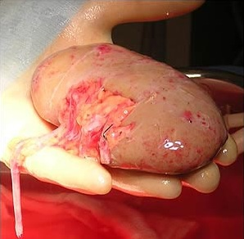
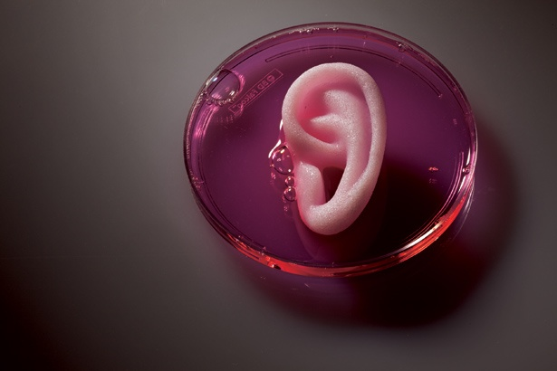
The University of Minnesota’s Doris Taylor has created a beating rat heart
The University of Michigan’s H. David Humes has created an artificial kidney
This has been tested on sheep, but never implanted
Anthony Atala’s group of scientists has made 22 other organs and tissues, among them ears and livers.

Slide 8
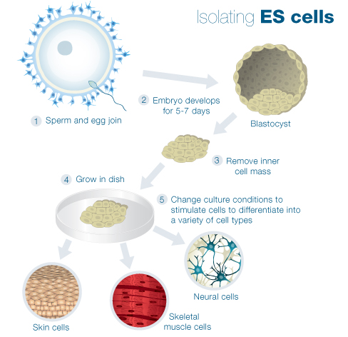
Where are stem cells harvested for treatment/transplant?
Stem Cells can be found in embryonic tissue and in the body
By removing an embryo’s inner mass, we can cultivate it on a Petri dish and change the environment to stimulate the growth of a certain cell
This is very controversial, because it would destroy an embryo

Slide 9
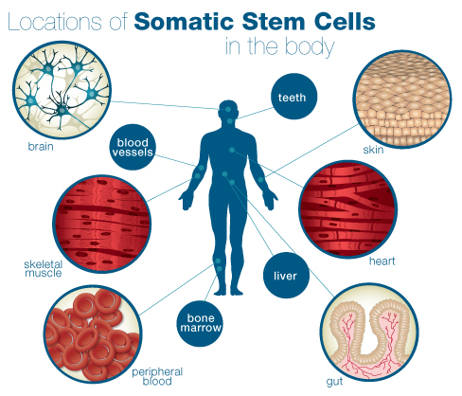
Where are stem cells harvested for treatment/transplant?
Stem cells also exist naturally in the human body, but are in low abundance and are difficult to grow and culture.

Slide 10
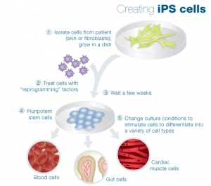
Induced pluripotent stem cells
AKA iPS cells
iPS cells come from the skin ,fat , or fibroblasts
iPS cells reprogram skin cells to go back to stem cells (dedifferentiation). Scientists believe this can result in inexpensive, pluripotent cells.

Slide 11
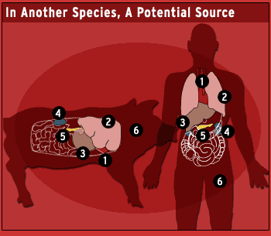
ORGANS: From other animals
By using genetically modified pigs, we may be able to get suitable organs to transplant into humans
Pig organs are coated with sugar molecules that trigger acute rejection in people.
If scientists produced pigs that do not have a sugar producing gene, we could transplant their organs to humans
Idea called xenotransplantation (xeno means
alien, strange, guest)

Slide 12
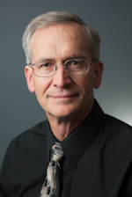
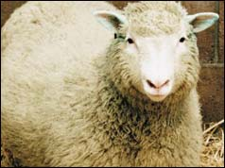
Idea developed by the University of Missouri’s Randall Prather
PPL Therapeutics PLC of Scotland produced five piglets that lack a copy of the sugar-producing gene.
This is the same company cloned Dolly the sheep.

Slide 13
Stem cell ADVANTAGES
Can cure many diseases that were thought to be incurable
Have the potential to be any cell in the body
Reduce the need for organ transplant

Slide 14
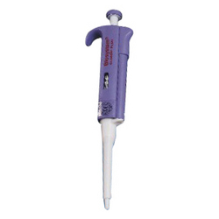
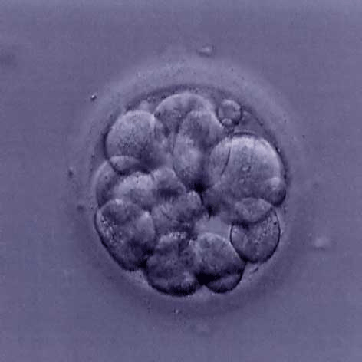
Stem Cell DISADVANTAGES
Have many ethical concerns that go along with them
In some cases very expensive

Slide 15
Works cited
http://learn.genetics.utah.edu/content/tech/stemcells/quickref/
http://learn.genetics.utah.edu/content/tech/stemcells/scissues/
http://stemcelltreatments.org/
http://news.nationalgeographic.com/news/2002/01/0103_020103TVclonedpig.html
http://www.cnn.com/2011/HEALTH/07/07/trachea.transplant/index.html
http://ngn.nationalgeographic.com/2011/03/big-idea/organ-regeneration-text

