Slide 1
Animal cloning
By olivia amoruso

Slide 2
Artificial embryo twinning
Separating an early embryo into a petri dish
Allowing it to develop
Placing the embryo into the mother’s uterus
The embryos will be genetically identical

Slide 3
Somatic cell nuclear transfer (scnt)
Isolate the somatic cell from a female
Remove nucleus from an egg cell
place the nucleus from the somatic cell into the egg cell
Cell will begin to grow into an embryo and then it will be implanted into the mother

Slide 4
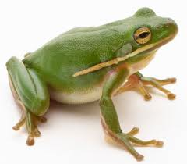
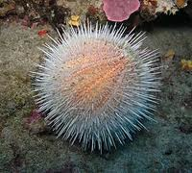
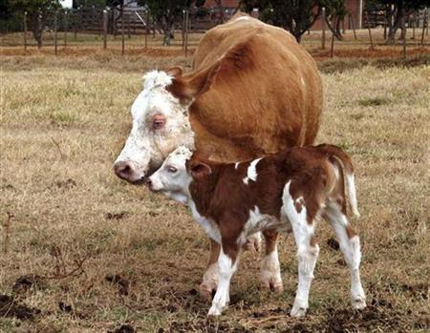
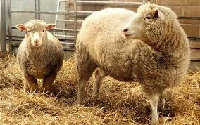
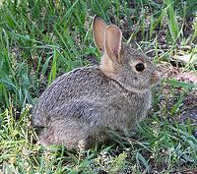
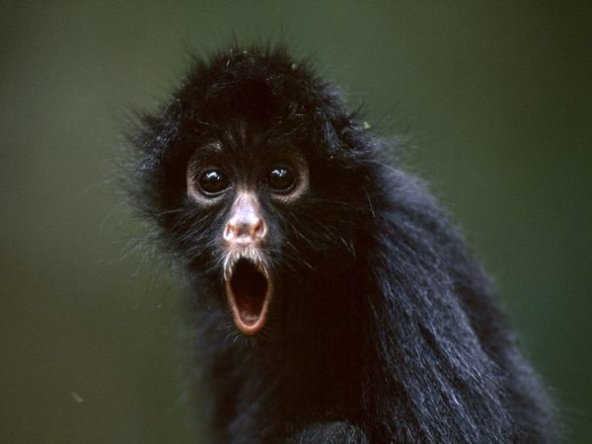
Animals cloned
Sea Urchin 1885
Salamander (first vertebrate animal cloned)
Frog (tadpoles resulted in abnormality)
Rabbit
Lamb and Sheep
Cow (nuclear transfer)
Dolly (First animal cloned using SCNT)
Monkeys (our closest relatives can be cloned)
Mouse

Slide 5
Dolly’s death
Dolly’s telomeres on the end’s of her chrosomes were shorter then average.
This caused Dolly to age faster and resulted in her death.

Slide 6
Cloning risks
Disadvantages
Challenges
Embryo my not divide properly
Implantation of new egg in uterus might fail
Can get “Large offspring Syndrome” which is when the offspring have abnormal organ sizes
Offspring with out LOS can develop kidney or brain malformations
We sometimes can’t reprogram the transferred nucleus as though it belongs in the exact embryotic cell.
Organisms cloned could have very short or long telomeres. This indicates how long the clone can survive

Slide 7
Reasons for cloning
We are not immune to diseases from animals, when we test the animals it is faster to clone then to wait for several generations for breeding
Cloning for stem cell research
Cows, sheep, and goats are being genetically engineered to produce drugs or proteins for humans.
Reproducing a deceased pet

Slide 8
Works cited
http://learn.genetics.utah.edu/content/tech/cloning/clonezone/
http://learn.genetics.utah.edu/content/tech/cloning/whatiscloning/
http://learn.genetics.utah.edu/content/tech/cloning/whyclone/
http://learn.genetics.utah.edu/content/tech/cloning/clissues/
http://learn.genetics.utah.edu/content/tech/cloning/cloningrisks/
Images are from googleimages.com

Slide 9
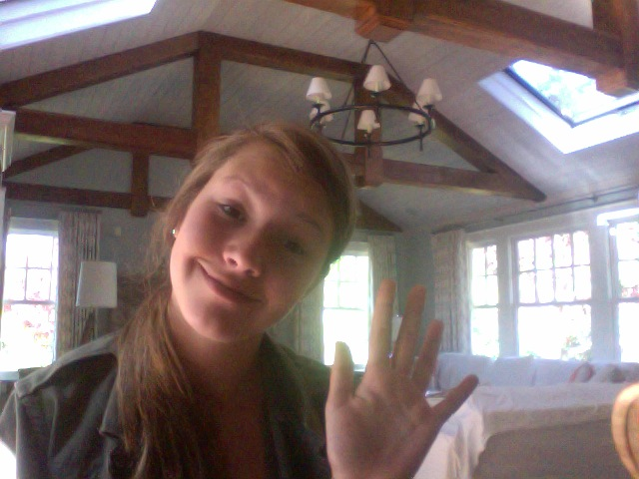
The end!
I hoped you enjoyed this slide show and you rock my socks Miss Napoli!
Ta-ta for now,
Olivia

