Slide 1
GMO Crops
By: Kaitlyn, Margaret & Victoria

Slide 2
GMO’s
It is when one organisms gene is transferred to another.
Also called “transgenic” for transfer of genes

Slide 3
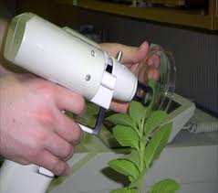
How Is It Produced?
Genetic Technology
Example: Cut and Paste Method With the gene gun

Slide 4
Gene Gun
It is a device for transforming cells with foreign DNA that works by propelling small metal spheres covered with DNA molecules into living cells.

Slide 5
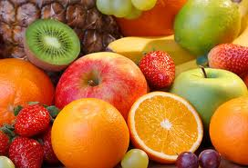
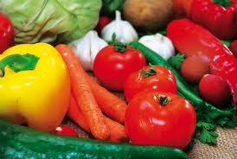
How it is relevant to one’s life…
It has been estimated that 70% of the processed
foods in the US contains at least one genetically
modified ingredient
The manufactures could do this to:
- Make the food seem fresher
-Withstand poor weather
-Improve Flavor
-Resistance to insects
-Increasing the Per acre yield

Slide 6
Advantages
Disadvantages
To produce higher quality crops
To produce more crops
To withstand poor weather
To cure diseases (Vaccination Banana, in the future)
They could be allergenic
Crossbreeding with wild populations (Scientists don’t know what could happen)

Slide 7
Golden Rice
3 genes were implanted into the rice. 2 was from daffodils and 1 was from a bacterium. These 3 genes gave the rice its golden color.

Slide 8
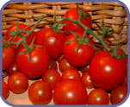
Long Lasting Tomatoes
These tomatoes are genetically modified to produce less of the substance that causes them to rot. It remains firm and fresh for a long time.

Slide 9
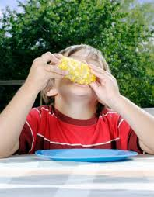
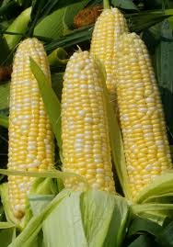
Insecticide Sweet Corn
Scientists have genetically modified sweet corn so it produces a poison which kills harmful insects. This means that the farmer doesn’t have to spray the corn with insecticide. The insect killing gene comes from the bacteria (Bacillus thuringiensis)This type of corn is also known as Bt-corn.

Slide 10
www.bionetonline.org/English/content/ff_cont3.htm
http://learn.genetics.utah.edu/archive/gmfoods/
http://www.bt.ucsd.edu/
http://www.mnn.com/green-tech/research-innovations/photos/12-bizarre-examples-of-genetic-engineering/banana-vaccines
http://wwww.biotech.iastate.edu/biotech_info_series/bio9.html

