Slide 1
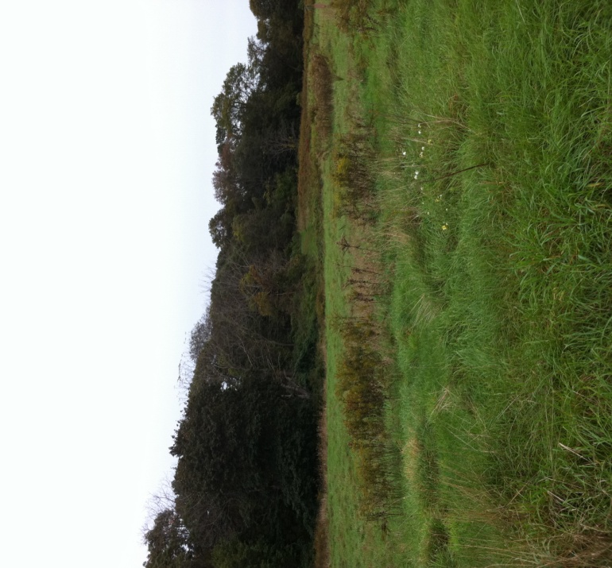
Nature Journal
By:
Johanna Zenn,
Kristen Incorvaia,
& Kristin Jaspers

Slide 2
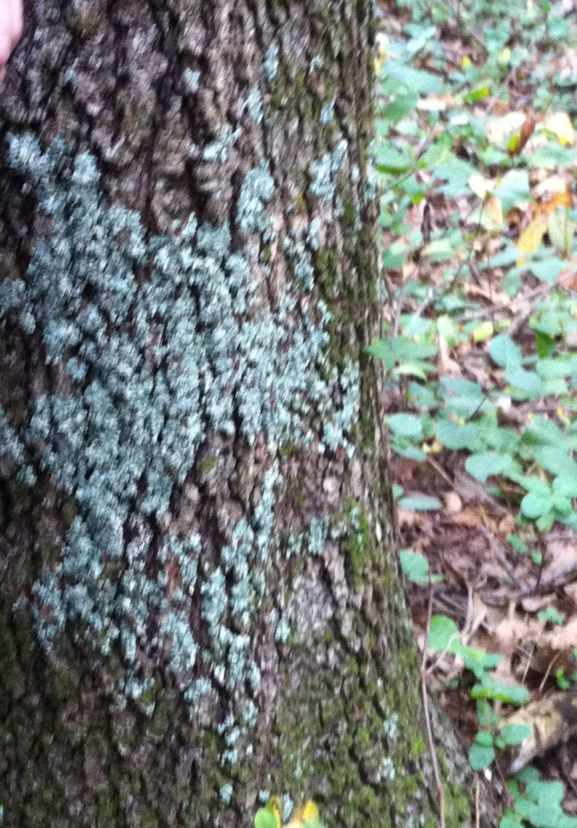
Symbiosis Lichen
Mutual relationship between algae and fungus
Pioneer organism
Fungus breaks down dead materials
While algae photosynthesizes

Slide 3
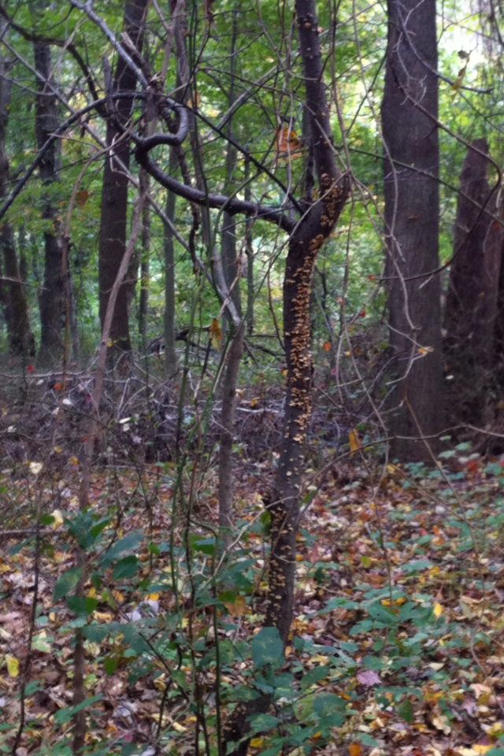
Nutritional relationship Decomposers
Many decomposers in forests
because of dead substances for them to break down
Decomposers break down dead organisms and use them for nutrients so plants use it to make more food

Slide 4
Ecological Succession Cedar Trees
Many cedar trees die because they grow slower than deciduous trees
the deciduous trees blocks the sunlight and limits the cedar trees from synthesizing

Slide 5
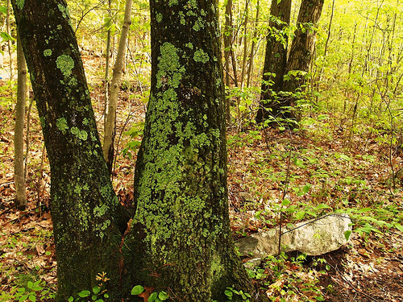
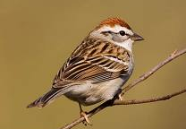
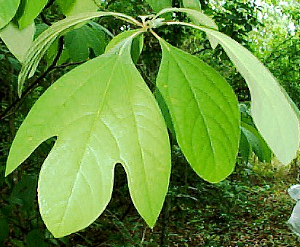
Mud on my shoes
Bugs in my hair
Look! Some lichen over there
A sparrow in the sky
Flying so high
Fungi decomposing all over the land
Is that a ladybug in my hand?
Leaves smell like root beer
I'm so happy Ms. Napoli took us here

