Slide 1
¡Bienvendios a la clase de 1a!
This is seventh grade Spanish
Sra. Monck-Rowley
L.O.T.E= Languages other than English
j-39
El horario de la Señora Monck-Rowley
Los períodos
1
2
3
4
5
6
7
8
9
Spanish 1A- j-33
Spanish 3H- j-33
Spanish 1A- j-33
LIBRE
Spanish 3H– j-33
Spanish 3H –j33
LIBRE
El deber de pasillo al frente del colegio
Spanish 3H j-36

Slide 2
Curriculum
Themes/Big Ideas for LOTE/World Languages
Personal ID/Social Relationships
Biographical Data/Personal Description
Family Life
Celebrations
Social Events
Meal Taking
Educational Systems
House and Home
Leisure
Social Customs
Volunteerism
Social Media
Global Awareness
Health & Welfare
Environmental issues
Food
Current Events
Language & National Identities
Government, Politics & Geography
Historical Events & Figures
Global Challenges & Economic Issues
Communication/Science Technology
Physical Environment
Climate/Weather
Food
Technology
Media
Internet & Communication
The Arts
Current Events
Fashion & Design
Architecture
Literature
Visual & Performing Arts
Music
Pop Culture
Contemporary Life
Educational/Careers
Travel/Lodging
Transportation
Leisure
Community/neighborhood
Shopping
Food

Slide 3
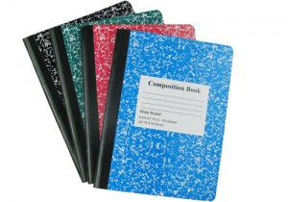
Las provisiones
4) un subrayador
1) Un cuaderno de mármol
*Usen las plumas para las pruebas y los exámenes
2) los lápices y las plumas
3) una carpeta
4) un correo electrónico
TODO EL AŇO!

Slide 4
las novelas
The purpose of the new curriculum is to develop and strengthen students’ abilities in listening, speaking, reading and writing in Spanish. This year’s 7th grade has had 5 years of FLES and this program will bridge the elementary and junior high school curriculum.
1
Each novel deals with thematic units we cover for 7th grade.
Such topics are: 1) Personal Identification
2) House and Home
3) School
4) Community
5) Tourism/Travel
6) Daily Life
2
Students will enhance their
reading comprehension skills
and be ready to participate in class
discussions regarding Ana, Carlos
and Patricia
3

Slide 5
Hagan Ahora=
‘Do now’
las preguntas
el lunes
el martes
el miércoles
el jueves
el viernes
No hay clases
1) ¿Cuál es la fecha de hoy?
2) ¿Qué día es hoy?
3) ¿Cómo te llamas?

Slide 6
las respuestas
el lunes | no hay clases
el martes
el miércoles
el jueves
el viernes
1) Hoy es el 1̊ de septiembre de 2015
2) Hoy es martes.
3) Me llamo Señora MR

Slide 7
Quizlet
Students have access to Quizlet via my website. This site has all
of the vocabulary from the unit on electronic flashcards! They can also download
Quizlet to their phones in order to practice vocabulary in the car, bus etc!
username: monckrow
You must join my group!
Do this tonight for hw. I have to accept you!

Slide 8
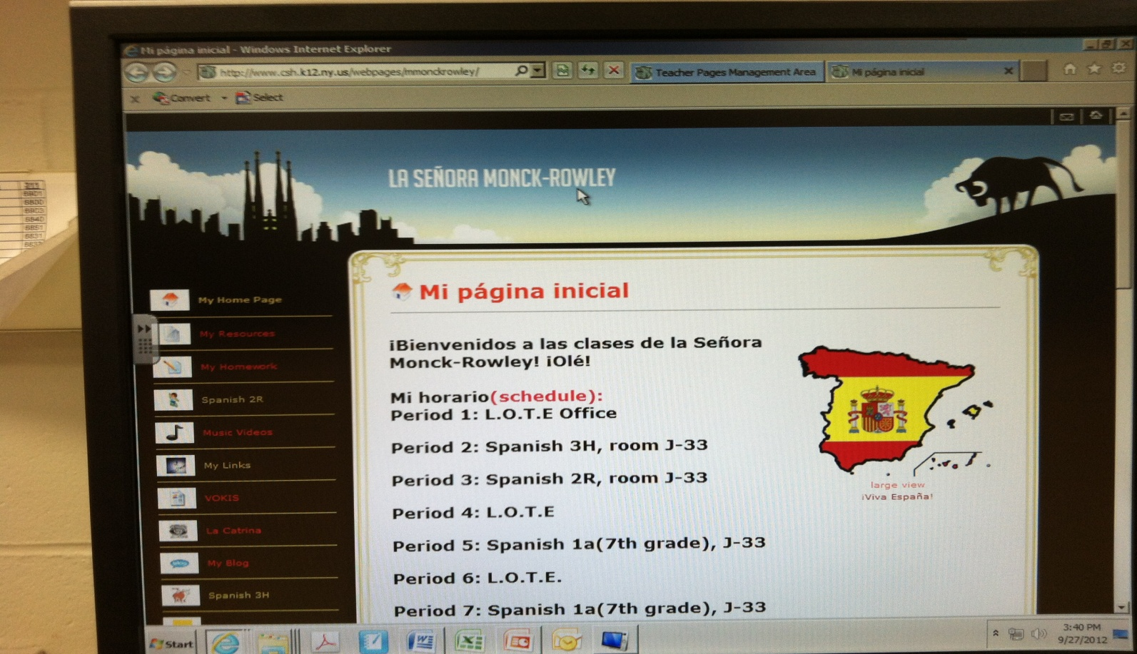
My website

Slide 9
EMAIL
The best way to contact me is via email. If you are sick,
have a questions, need a extra handout etc. Remember
to send an email BEFORE school ends.
If you email at night I won’t get it until the next day!
This is not an excuse for you to use!
mmonckrowley@csh.k12.ny.us

Slide 10
La tarea
*Students are assigned hw during the week and sometimes on the
weekend!
* Missed assignments can be made up the next day for ½ credit!
If students are ill they can have an extra day to make up assignments
when they return to school
Please ask your child to email me for assignments when
they are absent mmonckrowley@csh.k12.ny.us
MAKE A FRIEND IN CLASS WHO WILL BRING YOU THE ASSIGNMENTS,
SOMEONE WHO LIVES NEAR YOU

Slide 11
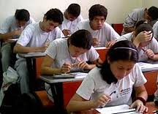
Wednesday
La prueba
*Students will be quizzed weekly please check the
portal up to a week later for the results
Students can see me for extra help the morning of to
review listening questions TEST DAY is Wednesday
Tuesday is a FREE day
.
*10 Listening questions given one –to-two
days before the quiz and students will be given
5 out of the 10 on quiz.
*If you are absent you must make-up the quiz within a week. If I announce a Quiz on Monday
and you are absent one day during the week you WILL take the quiz. You have been given
advanced notification and are responsible for obtaining worked missed via email or classmate.

Slide 12
Speaking=25% of grade
This is not participation! Students will have to speak at the end of the year for
the FLACS Regional Exam for 25points. The LOTE department considers
speaking to be a huge component of the grade! It’s a language they should be able
to converse in a simple conversation by the end of the year.

Slide 13
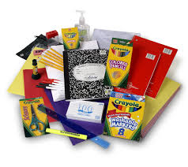
Participation
15% of the quarter grade
Be on time!
Bring materials to class: (notebook/pen/novela/folder).
Read aloud
Volunteer for <<hagan ahora>>
Volunteer during class discussions of novela.
No side conversations! Speaking with friends in class reduces
your grade.
7) SPEAK IN SPANISH ALWAYS: ASK QUESTIONS IN SPANISH!

Slide 14
Tardiness/Bathroom
Being ready means in your seat at the bell with <<Hagan Ahora>>sheet on desk!
*Students in 7th grade need to manage time and pack their backpacks
for the a few classes in the morning and then again at lunch.
Big adjustment from elementary school!
Students should use the bathroom during lunch.
When they arrive late the miss the explanation of the
<<hagan ahora>> and/or hw review
Emergencies are always taken into consideration and students
should not be asking to leave often
You are NOT going to the bathroom everyday!

Slide 15
La ayuda extra
IF YOU DON’T SEE ME…COME IN AND
ASK ANOTHER TEACHER, I MAY BE MAKING
COPYS OR IN THE LAVATORY!
DON’T DO A DRIVE BY!
LOTE Office
I am in the LOTE office by 7am EVERYDAY!
Students can make an appointment
to see me or they can stop in for help.
Great idea to review material
day before the quiz!
*Open the door and come in J-29
Across from junior high library!

Slide 16
You will receive a ZERO
on any assignment where
GOOGLE translate is used
Google Translate
PLEASE DON’T USE
Word Reference.com

Slide 17
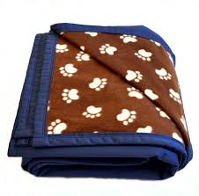
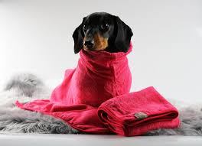
ARC= Animal Rescue Club
This year the ARC has been reinstated! Señorita Wilkens and I are
both co-advisors for this club and it is open to grades 7-12. The club we host fundraisers
as well as build cat houses and play ramps for the Huntington Little Shelter. Mr Healy
in woodworking will also be working with us on these projects.
-This winter we will collect blankets and towels for the shelter!
Plus many bake sales

Slide 18
International Club!
Madame Koob and I are co-advisors for this club. This year we
plan to visit the United nations for a tour, celebrate the Chinese New Year in
Manhattan and travel to Ellis Island. An in house event will be our first
annual International Night where we hope students will set up booths and share
their heritage!
Plus many bake sales!

Slide 19
write by hand
http://www.npr.org/2016/04/17/474525392/attention-students-put-your-laptops-away?utm_source=facebook.com&utm_medium=social&utm_campaign=npr&utm_term=nprnews&utm_content=20160826

