Slide 1
The Elements of Art
Mrs. McLaughlin

Slide 2
What are they? Line Shape Form Color Value Texture Space

Slide 3
What are the concepts of Line? Line - is a mark on a surface that describes a shape or outline. It can create texture and can be thick and thin. Types of line can include vertical, horizontal, diagonal, contour lines, gestural lines, hatching and cross hatching, and expressive lines.

Slide 4
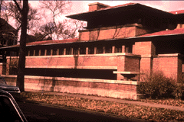
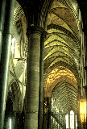
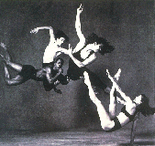
Horizontal, Vertical and Diagonal Lines
Horizontal line – suggests a feeling of quiet
and restfulness
Vertical lines communicate a feeling of loftiness
Diagonal lines suggest a feeling of movement
or direction.

Slide 5
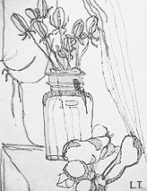
Contour Drawing: An "outline," and presents exterior edges of objects. A plain contour has a clean, connected line, no shading and emphasizes an open "shell" of the subject. Can become complex when adding shadow and texture.
Gesture Drawing: a method of training hands to quickly sketch what the brain has already seen. Stay focused,
Draw quickly, constant movement, no erasing!

Slide 6
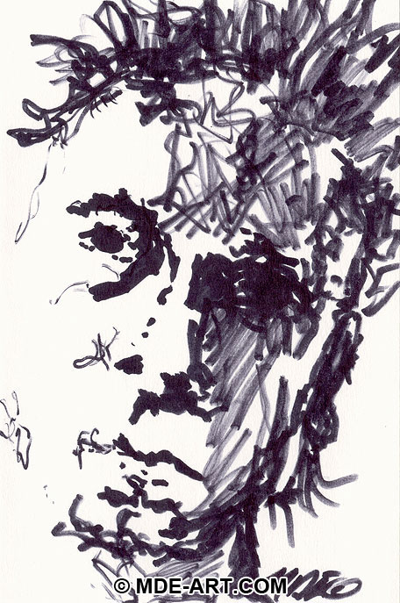
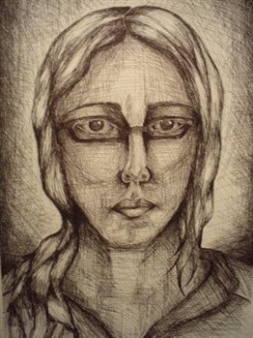
Expressive Lines: convey emotions based on their character and weight
Hatching/Cross Hatching: Using different line thicknesses you can give the illusion of weight and direction of light. Multiple lines, crossing one another give an illusion of form and texture

Slide 7
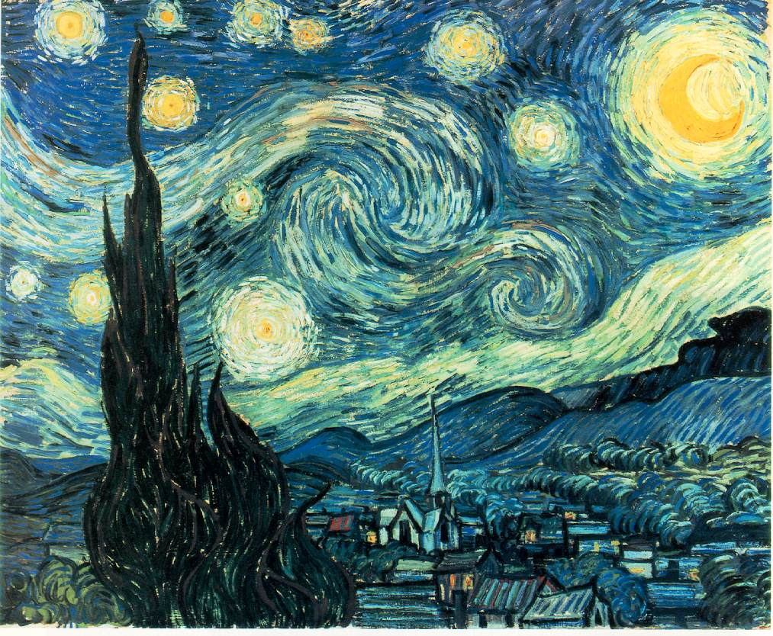
Starry Night Vincent Van Gogh 1889 Oil on Canvas

Slide 8
Shape Shape is an area contained within a line having two dimensions, length and width, and can be geometric or free-form.

Slide 9
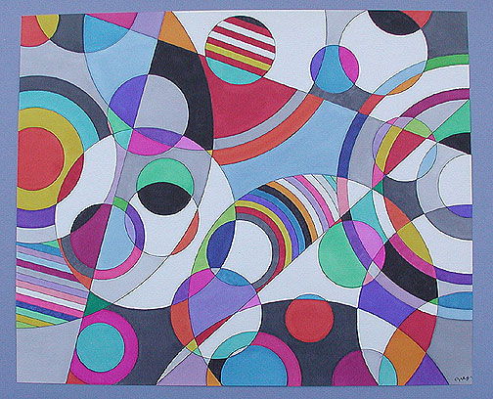
Geometric Shape

Slide 10
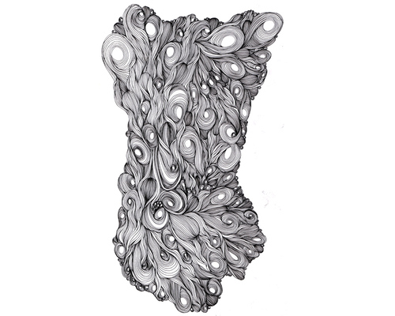
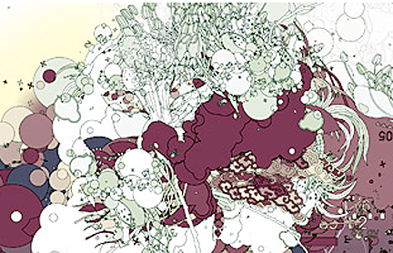
Organic Shape Abstract or non-objective
Organic Shapes – curvilinear or Geometric - rectilinear

Slide 11
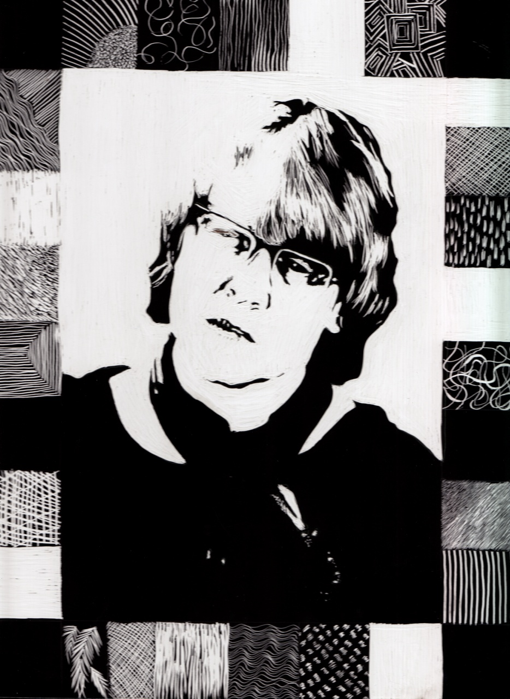
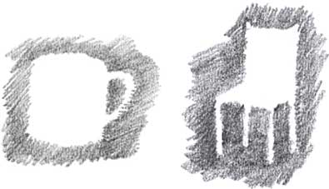
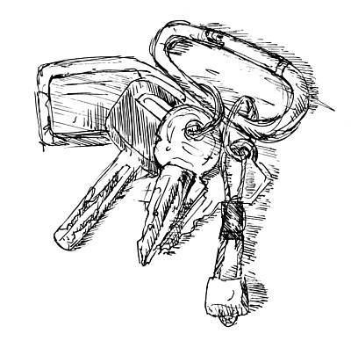
Positive and Negative Shapes
Hatching and cross-Hatching

Slide 12
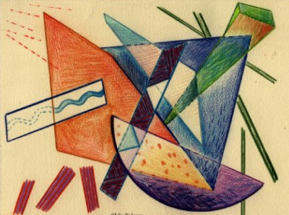
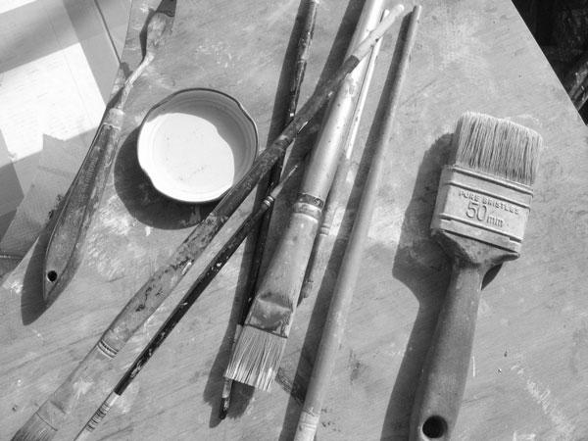
Non-representational (abstract) Shapes – reducing to its simplest form
Representational Shapes - able to
recognize objects within the piece of art

Slide 13
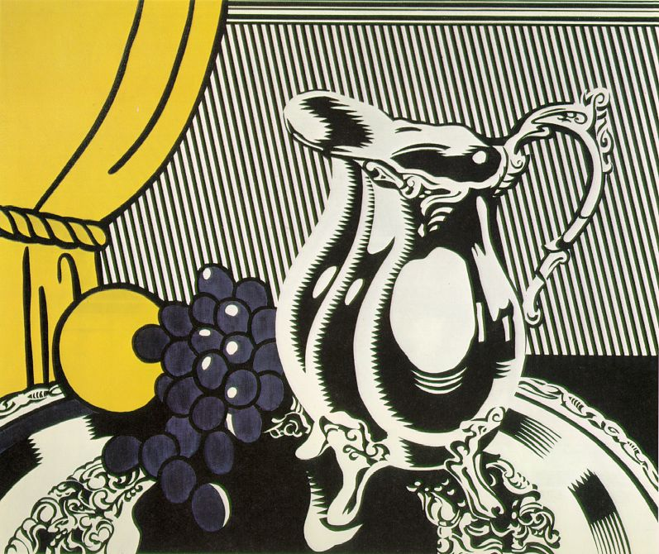
Still Life with Silver Pitcher 1972 Oil and Magna on canvas Roy Lichtenstein

Slide 14
Form Describes volume and mass, or the 3-dimensional aspects of objects that take up space. Forms can and should be viewed from many angles.

Slide 15
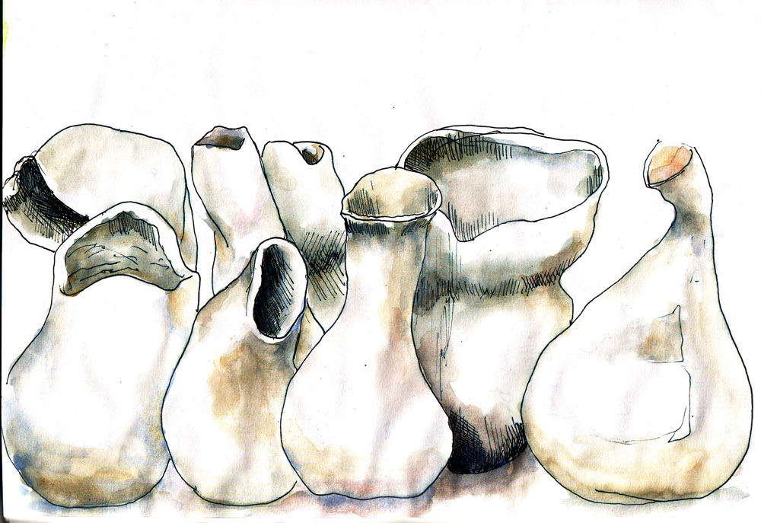
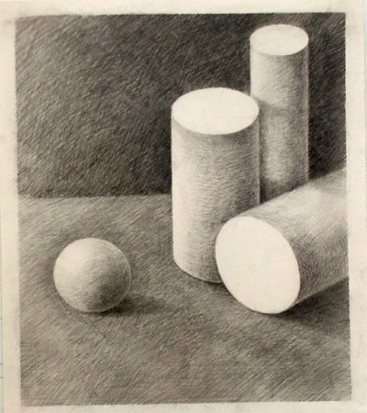
Organic Forms – rounded and flowing
Geometric forms –
Angular forms having straight edges

Slide 16
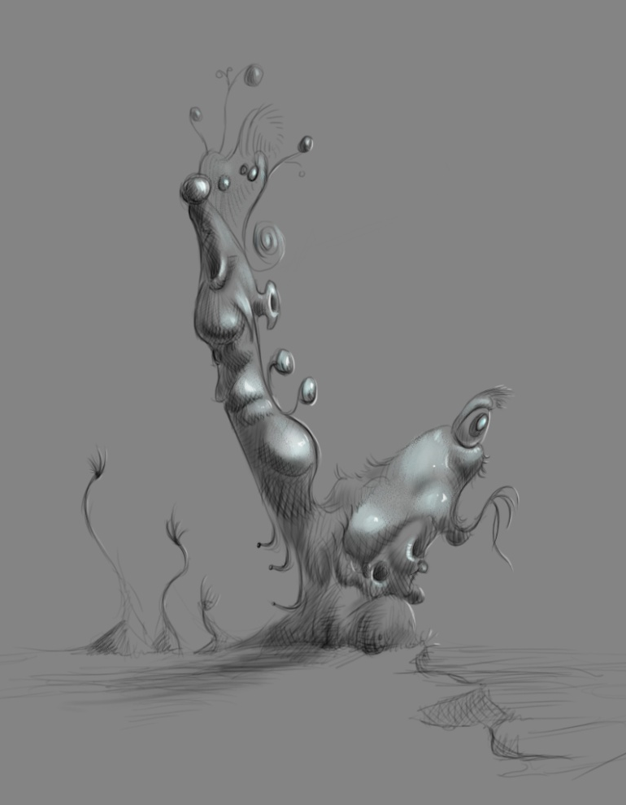
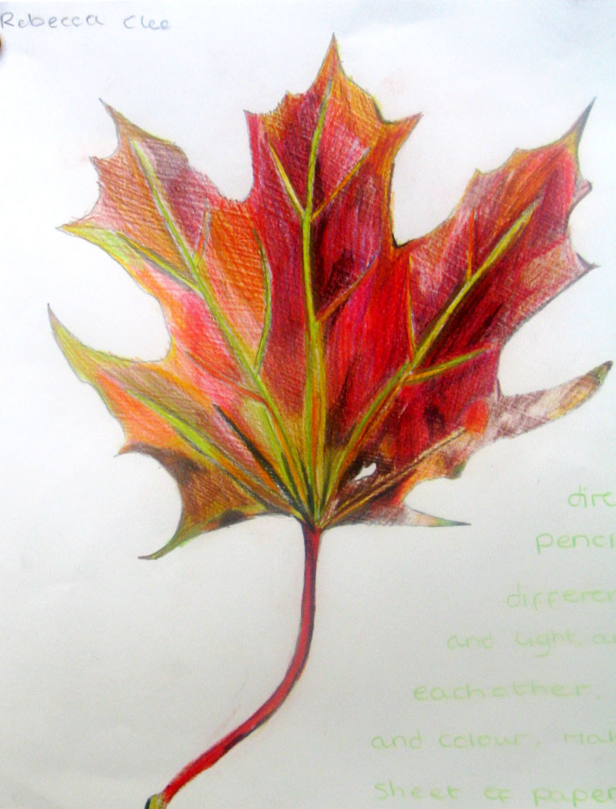
Natural Forms – forms from nature
Abstract Forms – simplify natural form

Slide 17
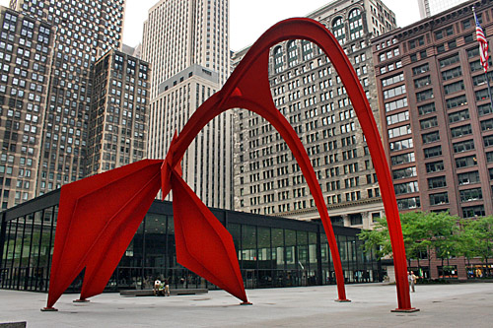
Pablo Picasso Metal (Critics speculate that this abstract work is intended to be a sculpture of a woman. Picasso himself never explained his intentions).

Slide 18
Color A product of light. The whiter the light, the more true the colors will be. A yellow light will change the appearance of all the colors creating a warmer palette.

Slide 19
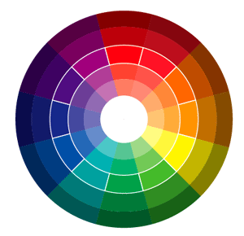
The color wheel
Value –
Lightness or darkness of a hue
Primary – yellow, red & blue
Shade –
Adding Black to a color
Secondary – orange, green & purple
Tint –
Adding white to a color
Tertiary – yellow-orange, yellow-green, blue-green, blue-violet,
red-violet,
red-orange
Intensity – purity of a color or hue

Slide 20
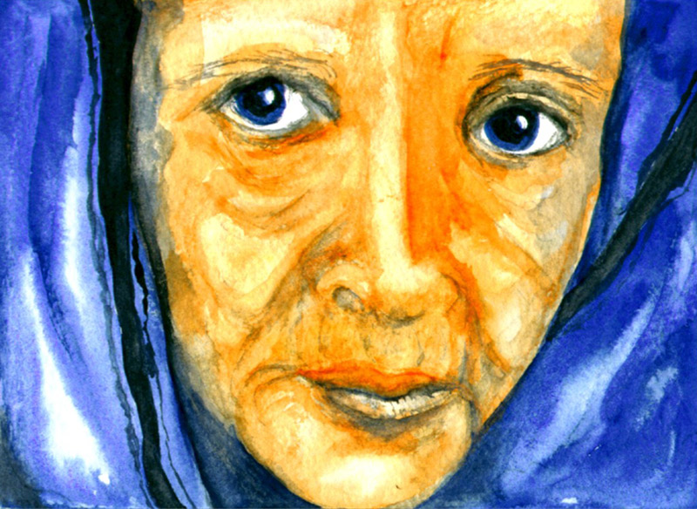
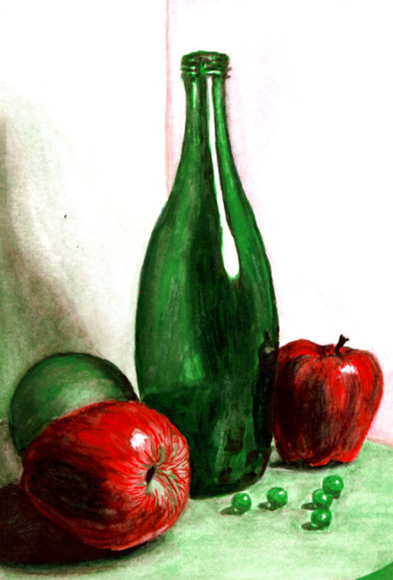
Complementary colors – using a complementary colors can make each color look brighter and more intense.
If you mix complementary colors you can neutralize them

Slide 21
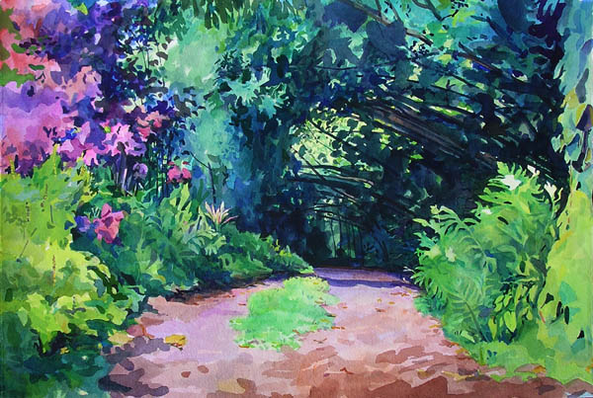
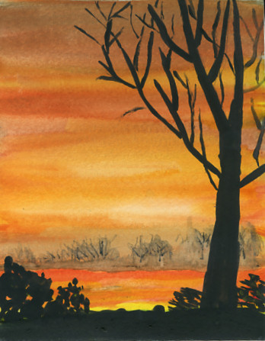
Warm Colors – Using reds, yellows, oranges and browns create a particular mood.
Cool Colors – Using Greens, Blues and violets create another mood.

Slide 22
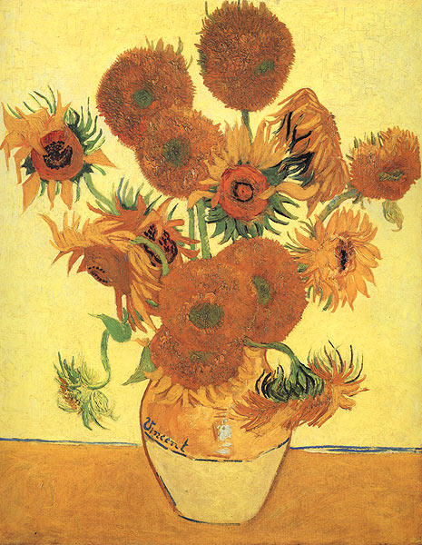
Sunflowers
1888
Oil on Canvas
- Vincent Van Gogh

Slide 23
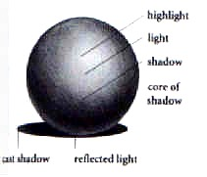
Value refers to dark and light. Value contrasts help us to see a two-dimensional work of art.

Slide 24
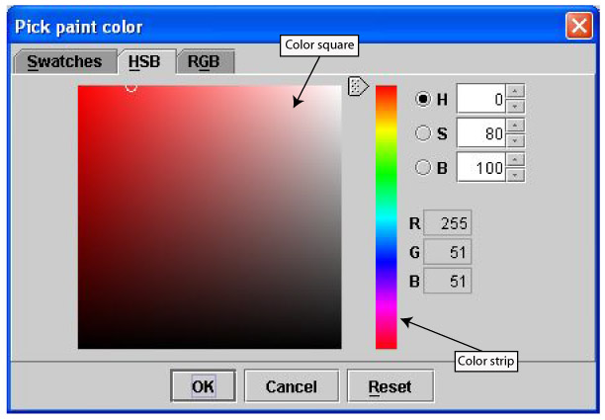
A value Scale – Black at one end, slowly add white to each block until 100% white.
Tints and Shades – A pure hue, slowly add black (shade) or white (tint)

Slide 25
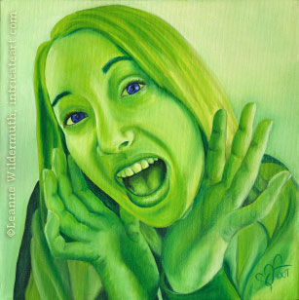
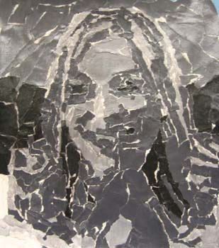
Monochromatic- consisting of one color or hue showing value contrasts
Value in Collage

Slide 26
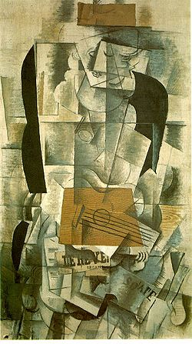
Woman with Guitar Georges Braque 1913 Oil and Charcoal on Canvas

Slide 27
Texture refers to a surface quality, both simulated (visual texture ie: rubbing or dry brush) and actual (actual textures ie: sandpaper, foil or application of pigment with brush).

Slide 28
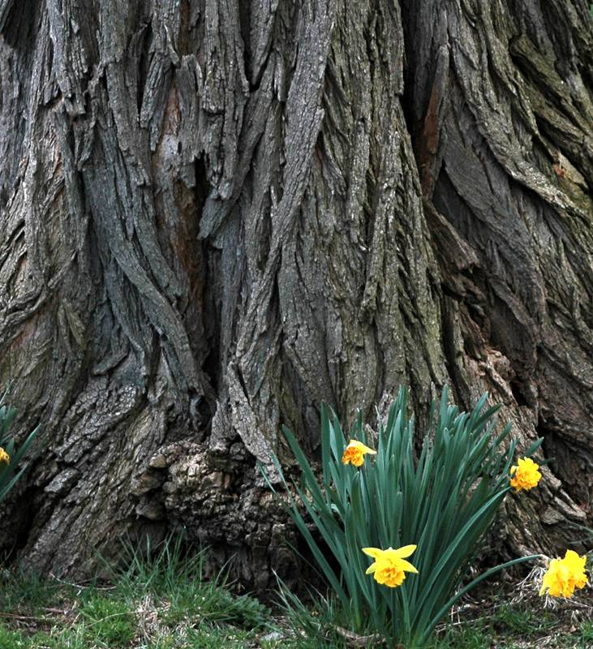
Natural textures – nature and environment

Slide 29
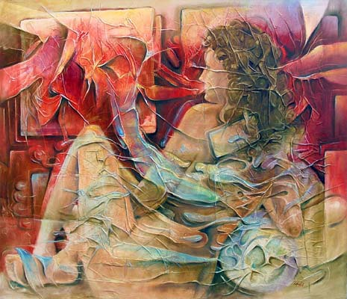
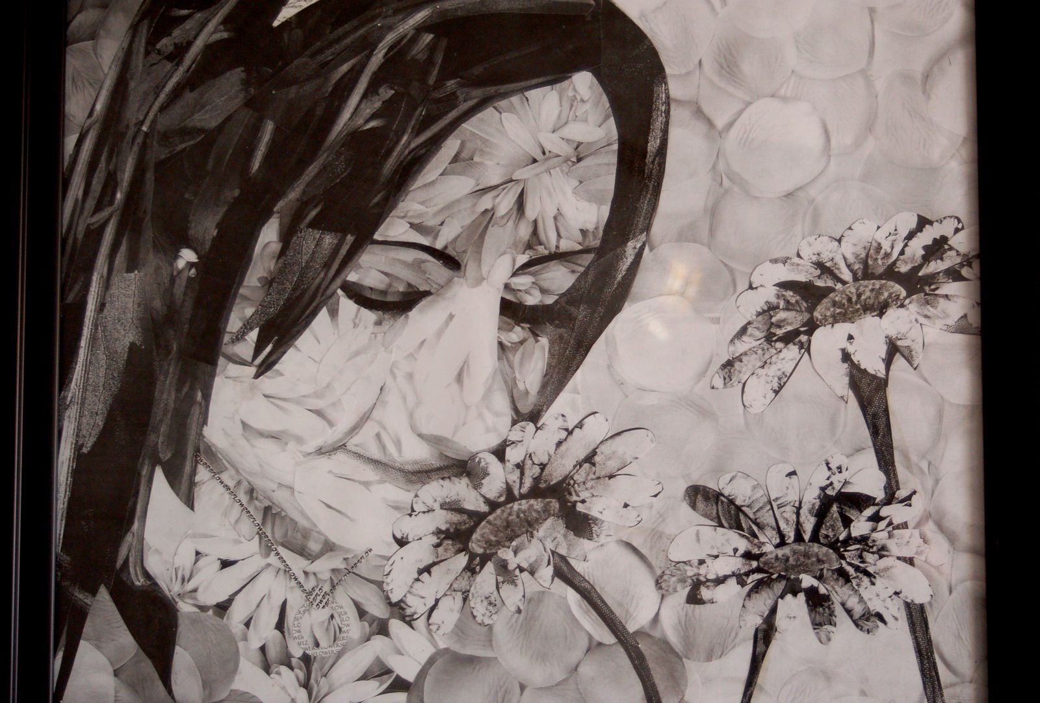
Actual Texture – surface quality you can feel with your fingers
Simulated
Texture – visual –when smooth surfaces
appear to be textured

Slide 30
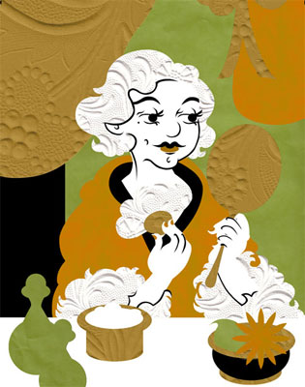
Actual Texture in Collage

Slide 31
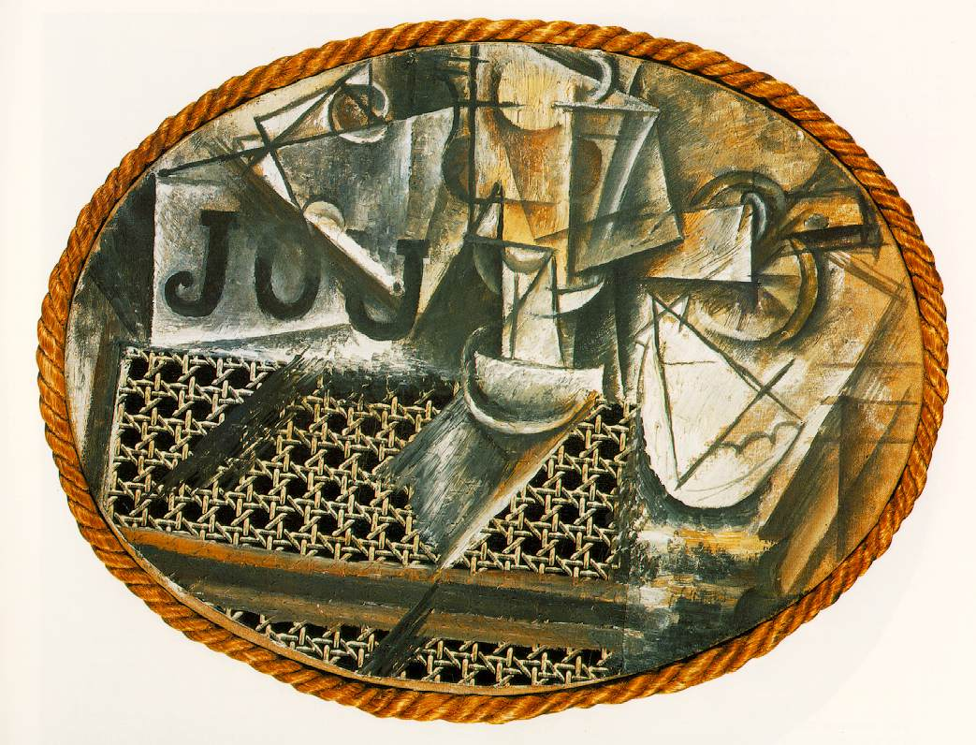
Still life with chair caning Pablo Picasso 1912 Mixed media

Slide 32
Space 3-dimensional volume that can be empty or filled with objects. It has width, height and depth.

Slide 33
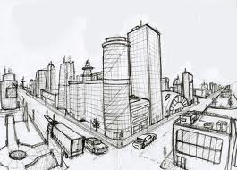
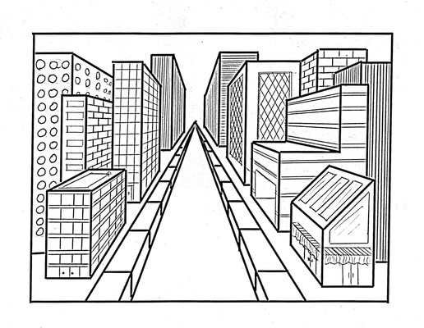
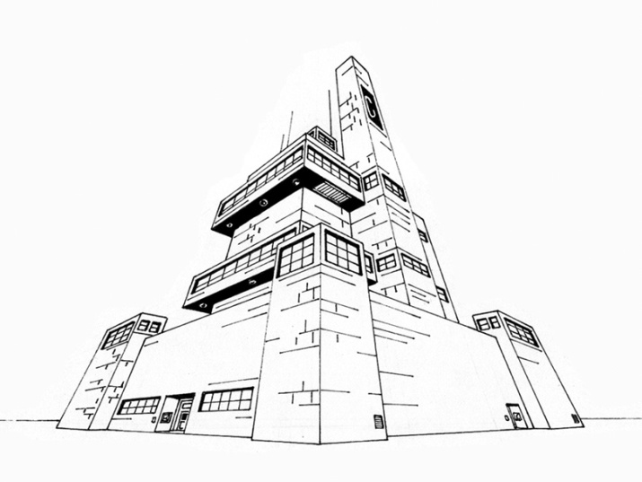
Linear Perspective – a way to organize objects in space using a horizon line, vanishing points and lines of convergence.
1-Point Perspective
2-Point Perspective
3-Point perspective

Slide 34
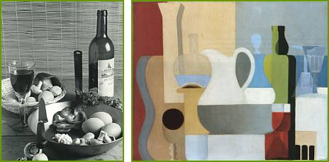
Overlapping objects – we sense space between objects when they overlap. When size varies, it increases space.
No overlapping

Slide 35
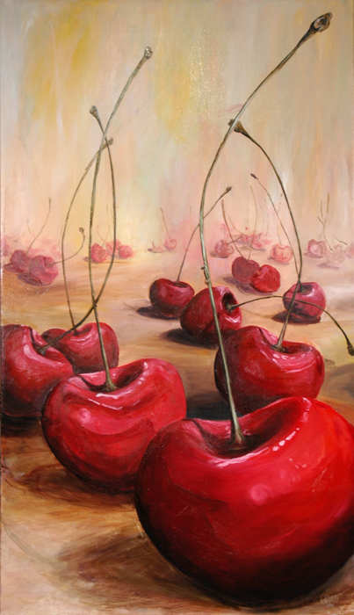
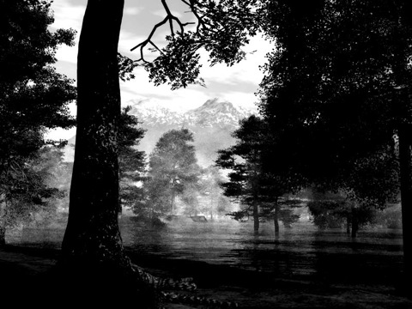
Atmospheric Perspective - a way of using color or value (or both) to show space or depth.

Slide 36
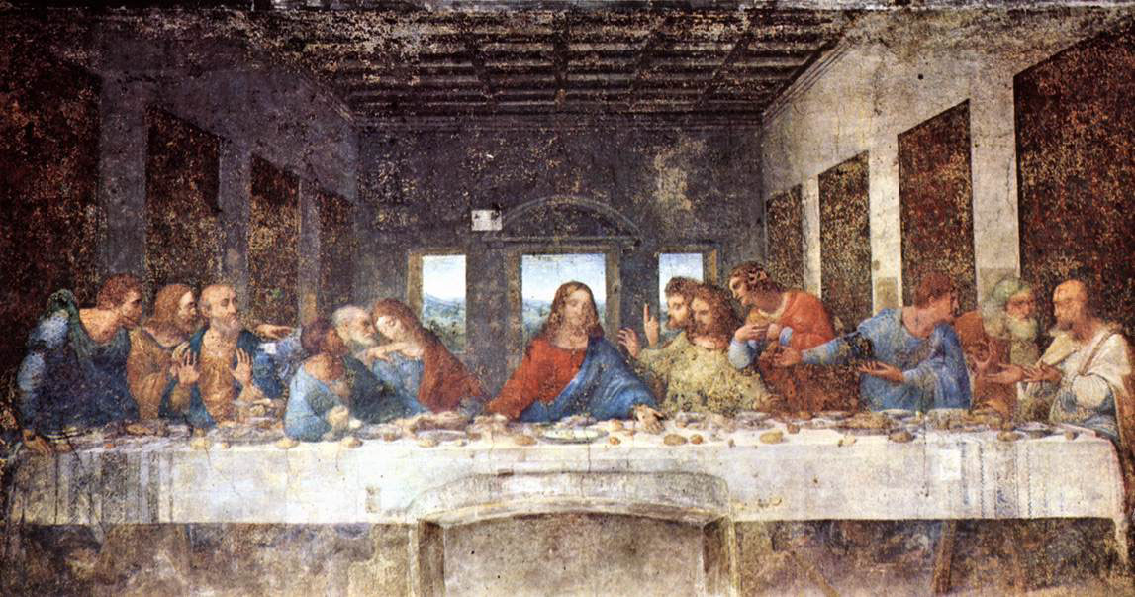
Last Supper Leonardo da Vinci 1490 tempera on gesso

