Slide 1
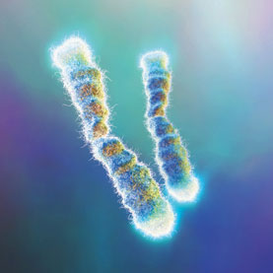
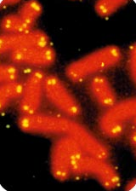
Telomeres
Telomeres, aging, cancer

Slide 2
What are telomeres?
Telomeres are the protective ends of a chromosome
Telomeres are made of sequences of TTAGGG on one strand of DNA connected to AATCCC on the other strand.

Slide 3
How do telomeres help us?
Telomeres are like the ends of a shoelace.
Telomeres prevent the deterioration of the chromosome and prevent damage when chromosomes hit each other.

Slide 4
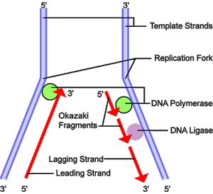
Issues with telomeres
When cells divide, the telomeres you have shorten until your cells cannot divide anymore; they may die.
Telomeres are susceptible to oxidative stress

Slide 5
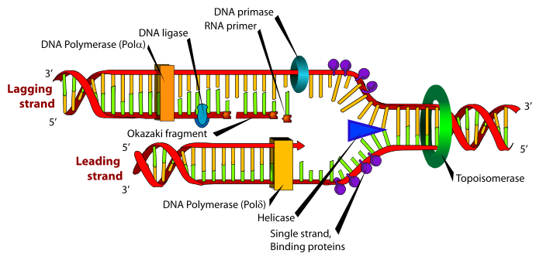
How this happens
DNA replication starts in the middle of the DNA. Helicase unzips DNA
This cause a leading and lagging strand, the leading strand has Polymerase to build the complimentary strand on it

Slide 6
How this happens(cont.)
RNA primer and Okazaki fragments attach to the lagging strand.
DNA Polymerase turns the RNA to DNA and DNA Ligase attaches the pieces to the lagging strand.
Every time DNA replicates, the lagging strand gets shorter which causes the telomeres get shorter

Slide 7
Aging and Telomeres
Cellular aging is senescence
Cells have a Hayflick Limit; when the telomere shortens until the cell dies
By giving cells telomerase they will live longer but increased telomere length is increased energy consumption (This has been proven with lab mice)

Slide 8
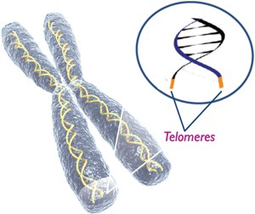
Aging and Telomeres
It has been thought that telomere activation might cause cancer
Although it might cause cancer, longer telomeres would protect against cancer

Slide 9
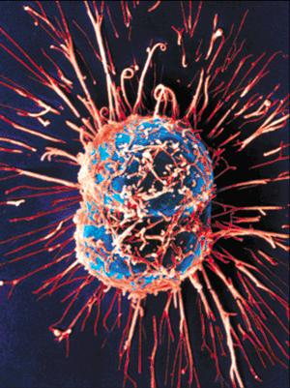
Telomeres and cancer
Cancer is the uncontrolled division of cells
Cancer is malignant, it divides until it forms a tumor which grows uncontrollably
Cancer has 10-20 times more telomerase than a somatic cell

Slide 10
Work Cited
http://en.wikipedia.org/wiki/Telomere(4-19-12)
http://en.wikipedia.org/wiki/Hayflick_limit(4-19-12)
http://Learn.gentics.utah.edu/content/begin/traits/telomeres/index.html(4-19-12)

